Slide 1
Addressing Picky and Disordered Eating in Young Children within Primary Care Monday, February 14th, 2022 12:30 – 1:30 PM Shauna P. Reinblatt, MD, FRCPC, DFAPA, DFAACAP Clinical Assistant Professor, University of Maryland School of Medicine
Maryland BHIPP Resilience Break Presentation
855-MD-BHIPP (632-4477)
www.mdbhipp.org

Slide 2
Who We Are – Maryland BHIPP
Offering support to pediatric primary care providers through free:
Telephone consultation (855-MD-BHIPP)
Resource & referral support
Training & education
Regionally specific social work co-location (Salisbury University and Morgan State University)
Project ECHO®
Direct Telespsychiatry & Telecounseling Services
Care coordination

Slide 3
Partners & Funding
BHIPP is supported by funding from the Maryland Department of Health, Behavioral Health Administration and operates as a collaboration between the University of Maryland School of Medicine, the Johns Hopkins University School of Medicine, Salisbury University and Morgan State University.
This program is supported by the Health Resources and Services Administration (HRSA) of the U.S. Department of Health and Human Services (HHS) as part of an award totaling $433,296 with approximately 20% financed by non-governmental sources. The contents of this presentation are those of the author(s) and do not necessarily represent the official views of, nor an endorsement, by HRSA, HHS or the U.S. Government. For more information, visit www.hrsa.gov.

Slide 4
BHIPP is Available to Provide Support to PCPs During the Pandemic
Ways to Connect:
Visit our COVID-19 Resource Page:
www.mdbhipp.org
Sign up for our newsletter:
https://mdbhipp.org/contact.html
Follow us on Facebook:
https://www.facebook.com/MDBHIPP/
Follow us on Twitter:
https://twitter.com/MDBHIPP

Slide 5
Meet The Presenter
Shauna P. Reinblatt, MD is a Clinical Assistant Professor at the University of Maryland School of Medicine (UMDSOM), Department of Psychiatry, Division of Child and Adolescent Psychiatry. She is Board Certified in General Adult, Child & Adolescent, and Consultation Liaison Psychiatry. Prior to her becoming a psychiatrist, Dr. Reinblatt worked as a family doctor in Canada.
Dr. Reinblatt was a member of the full-time faculty at the Johns Hopkins University School of Medicine in the Department of Psychiatry for over a decade. During this time, she developed specialized clinical expertise working with children, adolescents, and adults with eating disorders in addition to her clinical child psychiatric work with youth.

Slide 6
Disclosures
Dr. Reinblatt has no financial relationships with ineligible companies (either individually or as a group)

Slide 7
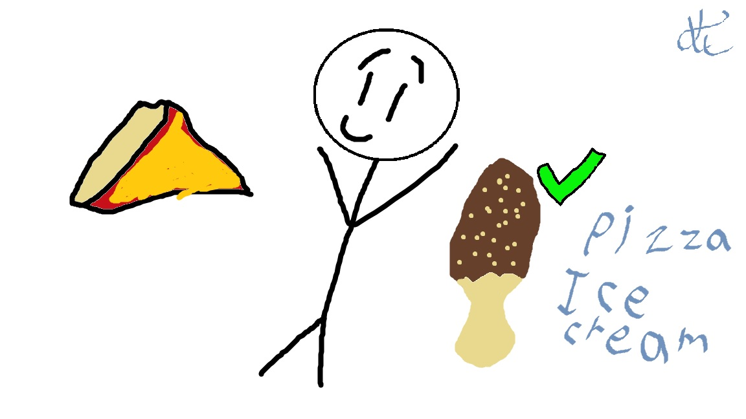
Addressing Picky and Disordered Eating
Identify clinical features of picky eating in younger children
Expand your knowledge of Avoidant/ Restrictive Food Intake Disorder (ARFID)
Learn some preliminary management strategies for eating disorder symptoms (including ARFID)

Slide 8
Addressing Picky and Disordered Eating
Identify clinical features of picky eating in younger children
Expand your knowledge of Avoidant/ Restrictive Food Intake Disorder (ARFID)
Learn some preliminary management strategies for eating disorder symptoms (including ARFID)
Notes:
No conflicts of interest to report
May discuss off label use of medication that are not FDA approved for use in children.
This talk is informational ; the information conveyed does not constitute clinical supervision towards any specific patients.
Provide and overview of eating disorder categories with the goal of assessing warning signs (using clinical techniques and screeners), and implementing treatment approaches and referral strategies. For primary care
patients may present c/o problems secondary to their eating disorder – obesity, GI symptoms, syncope, seizure etc…Important to know about signs and symptoms and to screen patients if you suspect an underlying ED; and we will also review some screeners.
Given the nature of Eds patients may be very ambivalent about treatment and we will discuss some approaches to engage them into treatment so that they can be referred for mental health treatments and when to refer.

Slide 9
Fictional Case 1- Ashley
Ashley is a 3-year-old girl who loves attending preschool and seeing her friends. She likes to direct the games that she plays with her friends, but she is redirectable. She does not eat any of the food provided at the preschool and says she will eat when she gets home.
However, she also does not eat many of the food items mom feeds her at either snack or mealtime. She pushes away leafy greens in particular and mom has unsuccessfully attempted to feed her several new foods.
She has met her developmental milestones as expected and is growing well without any significant past medical or psychiatric history reported.

Slide 10
Picky Eating (or Selective Eating) Characteristics
Developmentally normal picky eating phase from around 18 months to age 3-4 years (up to 6 years of age maximum)
Rejection of novel food
Strong food preferences
Reflects control of choice
Does not affect growth and are not underweight
Do not typically need supplements to keep growing
Not a psychiatric disorder (may have behaviors like tantrums)
No significant decline in psychosocial function
No sensory symptoms or fear of eating

Slide 12
Prevalence Picky Eating
Prevalence of Picky Eating : 8 to 50% (variable)
Prevalence (prospective study 120 youth aged 2-11 years):
13-22% prevalence at any given age (Mascola Eat Behav. 2010 Dec ; 11(4)
40 % had duration over two years
Incidence declined as youth aged
More likely chronic (“trait like”) with stronger food dislikes, less variety of foods & more tantrums and struggles around eating
Prevalence (large population-based study):
27 % at age 1.5 years,
28% at 3 years,
13% at 6 year of age
4% Late onset at 6 years or more
(Cardona Cano IJED 2015)

Slide 13
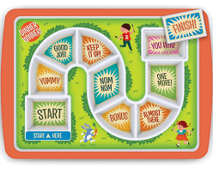
Addressing Picky Eating (or Selective Eating)
Parental /Behavioral Management:
Using positive rewards for positive behaviors (like trying a new food)
Decreasing attention for negative behaviors (like food refusal tantrums)
Mealtime exposures (multiple exposures to new foods)
Establish routine mealtimes with spacing from snacks
More severe picky eating may need more structured professional approach with the behavioral plan.

Slide 14
Addressing Picky Eating
Modeling Positive Eating behavior
Family meals, modeling behavior (varied diet )
Involving child in food-related activities
Grocery shopping and cooking
Gardening re: veg?
Reading books
Using special dishes to progress to preferred foods

Slide 15
Longitudinal Course of Picky Eating?
Difficult to compare trajectory between studies (definitions of picky eating, duration differ)
Two-year longitudinal follow-up of young children with picky eating in Quebec Canada found picky eating persisted from early to late childhood (5.5% had picky eating from age 2.5 to 4 years) (Dubois 2007 Int J Beh Nutrition& phys activity)
Picky eating remained stable in another study from early to late childhood but there were more non-eating behaviors (internalizing and externalizing) (Jacobi C et al. IJED 2008; 41)

Slide 16
Longitudinal course of picky eating…?
Eating too slowly
Picky eating
Eating too little
Food avoidance
Early childhood picky eating, eating too slowly, eating too little and food avoidance reported to be stable until late childhood.
Early childhood eating concerns (particularly picky eating) may increase risk of eating problems in adolescence but the trajectory later in life is still unclear. (no ARFID dx then complicates conclusions) ( Marchi, M. and Cohen P. JAACAP 1990 Jan 29(1)
32% Picky Eating remission in epidemiologic study remitted by age 4 years (Cardona Cano IJED 2015)
Trajectories of Picky Eating in Low-Income US children: Picky eating remained stable, established by 4 years; Higher picky eating (‘trait like”)→ associated with lower BMI (Fernandez et al. June 2020 Ac Peds)
Notes:
suggesting possible need for early intervention?

Slide 17
Addressing Picky and Disordered Eating
Identify clinical features of picky eating in younger children
Expand your knowledge of Avoidant/ Restrictive Food Intake Disorder (ARFID)
Learn some preliminary management strategies for eating disorder symptoms (including ARFID)

Slide 18
ARFID & PRIMARY CARE PEDIATRICS
Pediatricians are often the first to encounter youth with symptoms of ARFID.
American Academy of Pediatrics suggests screening for eating disorders *; When do yearly follow up of growth curve, might raise flags?
Survey of pediatricians found that only 37% were familiar with ARFID and only a third correctly applied the diagnostic criteria (Katzman 2014; Ped Child Health 0ct 14
Up to half of the children with ARFID have medical and psychiatric comorbidities and may be seen in pediatric specialists’ offices as well (Grubb Jama Peds 2021)
Decreased energy and growth occurs at an important time developmentally when the child needs it in preadolescence/adolescence (not just picky eating)
*AAP Policy statement Jan 2003 Pediatrics

Slide 19
Fictional Case 2- Lori
Lori is a 5-year-old girl with ADHD on Ritalin 5 mg BID. She attends Kindergarten. Her BMI % is at low end of the curve now.
Although always a rather picky eater, about 6 months ago, a piece of the apple she was eating felt like it got stuck in her throat. After coughing a lot, seeing the school nurse, she felt improved enough to return to class. Although there were no medical sequalae, she then stopped eating apples.
Notes:
She watches cooking videos.

Slide 20
(CONTINUED CASE 2- Lori)
“Lori” previously ate 7 items including orange Kraft mac and cheese, hamburger (only frozen of a certain brand), orange, fast food chicken nuggets, orange baby carrots, orange juice, fries.
When Lori was ill recently, she vomited after mac and cheese and now is avoiding that food as well.

Slide 21
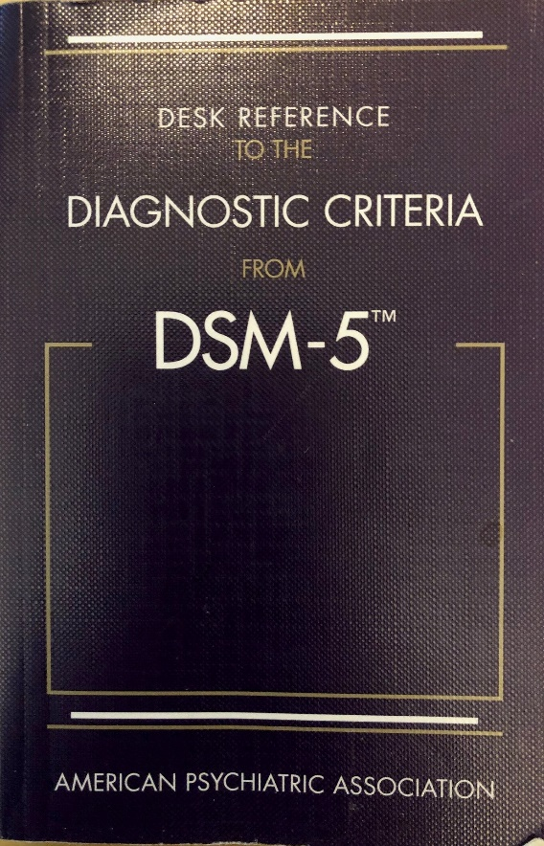
DSM/ History ARFID
DSM IV:
Feeding disorder of infancy and childhood & Eating disorder Not otherwise specified
Age onset criteria (up to age 6)
DSM-5
Avoidant/Restrictive Food Intake Disorder (ARFID)– no age restriction ; nutritional qualifiers
Unspecified Eating Disorder
Other Specified Eating Disorders (OSFED)

Slide 22
Avoidant/Restrictive Intake Disorder (ARFID)
Pattern of eating limited in variety and/or amount, which is often associated with medical and psychiatric sequalae.
Not just occasional picky eating.
Not due to lack of available food
Not motivated by fear of weight gain nor shape concerns.
If co-occurring with a medical or psychiatric problem must be severe enough to require attention in and of itself.

Slide 23
ARFID Dimensional Model –
Lack of Interest
Fear of Aversive Consequences
Food Selectivity & Sensory Sensitivity
Lack of Interest (LOI):
Forgets meals, appetite difference
Visceral hypersensitivity?
2. Food Selectivity / Sensory Sensitivity:
“Supertaster”?
Smell or Feel (texture) /sensory sensitivity
3. Fear of Aversive consequences:
Fear of something happening like Vomiting or choking

Slide 24
Differentiation from other eating disorders:
Weight
Shape

Slide 25
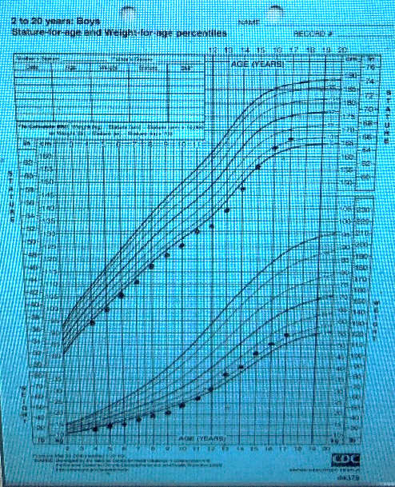
ARFID associated with one or more of associated symptoms:
1. significant weight loss or failure to achieve expected growth (or weight gain)
2. Nutritional deficiency (significant)
3. Dependance on enteral feeding or oral supplements
4. Marked interference for psychosocial functioning

Slide 26
ARFID-Lack of interest (LOI)
Does your child/Do you:
forget to eat a meal or skip them?
Have less of an appetite than friends/ peers?
get full more quickly than others? (Early satiety or cues to eat may be affected?
Leads to lower BMI > peers
Typically, slightly younger than fear of adverse consequence group (may start a bit earlier)
Unclear if different physiology (Visceral hypersensitivity?)

Slide 27
ARFID- Fear of Adverse Consequences
Does your child or do you:
Have a fear of choking, gagging or vomiting? (if so, is it on purpose? )
Recall an event where (you or your child) unexpectedly choked, gagged or vomited?
Worry about an allergic reaction?
Prefer puree, soft or liquid food?
Have any comorbid anxiety diagnosis or problems?

Slide 28
ARFID- Food sensitivity
Is your child /are you:
Much more sensitive to taste texture, color or temperature of foods than friends? (not just mild picky eating or developing palate)
More likely to reject non-preferred foods , which are perceived as extra-sensitive.
Have rituals--- like food should not touch.
Have had symptoms a longtime,( i.e. since toddlerhood)
Have other psychiatric disorders comorbidly such as Autism Spectrum Disorder; OCD, ADHD or oppositional behavior.

Slide 29
Fictional Case 2- Lori
Lori is a 5-year-old girl with ADHD on Ritalin 5 mg BID. She attends Kindergarten. Her BMI % is at low end of the curve now.
Although always a rather picky eater, about 6 months ago, a piece of the apple she was eating felt like it got stuck in her throat. After coughing a lot, seeing the school nurse, she felt improved enough to return to class. Although there were no medical sequalae, she then stopped eating apples.
Notes:
She watches cooking videos.

Slide 30
(CONTINUED CASE 2- Lori)
“Lori” previously ate 7 items including orange Kraft mac and cheese, hamburger (only frozen of a certain brand), orange, fast food chicken nuggets, orange baby carrots, orange juice, fries.
When Lori was ill recently, she vomited after mac and cheese and now is avoiding that food as well.

Slide 31
PREVALENCE Rates ARFID
Population-based survey Swiss schools (aged 8-13) prevalence 3% ARFID.(Kurtz 2015)
Three-month prevalence in of 0.3% ARFID Australian self-report study of age 15 and up ; prevalence (3 month) 0.3% (95%CI 0.1,0.5) (Hay 2017)
Equal prevalence male to female (both above studies) .
Largest community based prospective study of ARFID 24 months (Canadian) : 2.02/100,000 prevalence (Katzman JAMA Peds 2021)
23% ARFID in Partial Hospital eating disorder program (retrospective
chart review ) (Nicely et al. IJED 2014 (21)
Notes:
Most important time for growth

Slide 32
Assessment
Safety -(medical and behavioral)
BMI; growth curve
Hydration ; vital signs
Suicidal ideation screen
Labs – nutritional indices (vitamins, iron levels…)
[vit C (scurvy), vit A (oclar), B12, folate, Vit D, thiamine, K, PO4 albumin etc. ]
CBC (anemia), TSH
Other- EKG ? if electrolytic or cardiac concerns
Physical exam- if low weight may be malnourished and overlap of those symptoms with any malnutrition cause (ex like AN).

Slide 33
Nine Item Avoidant/Restrictive Food Intake Disorder SCREEN (NIAS)
Range of scores for subscales
(0 to 15):
Picky eating (cutoff 10)
Lack of appetite (cutoff 9)
Fear (cut off 7)

Slide 34
NIAS (Continued)
Add to NIAS score ; Criteria for ARFID (Any of the 4 below answered as a YES):
Underweight/recent weight loss/stunted growth YES or NO
Nutritional deficiency YES or NO
Dependence on supplements YES or NO
Difficulty with social situation/ school or work YES or NO

Slide 35
Differential Diagnosis?
Medical causes of weight fluctuation
Medical causes of purging or other symptoms
Food insecurity
Eating disorders (Anorexia Nervosa or Bulimia Nervosa)
Developmental picky eating
Comorbid psychiatric illness
Autism
OCD
Anxiety
ADHD
Depression

Slide 36
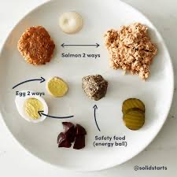
Psychiatric Comorbidity
Clinical experience suggests common with up to 40% of kids with ARFID having comorbid psych dx
Screen for ADHD and other comorbidities like anxiety
Behavioral changes?
Comorbid psychiatric symptom exacerbation
Neuropsychiatric Disorders such as ASD-rigidity, rule bound; ritualistic eating. (food touching etc.)?
History of autism or developmental history of social and other deficits?

Slide 37
RED FLAGS
Longer duration or a history of picky eating (reinforces avoidance behavior)
New, dramatic weight loss
New lab work findings
New physical exam findings
New comorbid psychiatric complaints
New comorbid medical (GI in particular) complaints
Notes:
Hypokalemia
Bradycardia or large parotids
(falling off growth curve)
Versus losing weight in adulthood.

Slide 38
Summary of main behavioral screening questions for ARFID:
What reason does youth give for not eating (r/o shape and weight concerns)
What does youth think of weight loss?
Food avoidance
Neophobia (fear of new foods)
Nausea or early satiety/abdominal pain
Fear of choking, vomiting when eat or having an allergic reaction
Notes:
Don’t need to endorse symptoms, can use behaviors and extrapolate
How often symptoms
(if you had a magic wand)
What you look like – body image

Slide 39
Addressing Picky and Disordered Eating
Identify clinical features of picky eating in younger children
Expand your knowledge of Avoidant/ Restrictive Food Intake Disorder (ARFID)
Learn some preliminary management strategies for eating disorder symptoms (including ARFID)
Notes:
This talk is informational ; the information conveyed does not constitute clinical supervision towards any specific patients.
Provide and overview of eating disorder categories with the goal of assessing warning signs (using clinical techniques and screeners), and implementing treatment approaches and referral strategies. For primary care
patients may present c/o problems secondary to their eating disorder – obesity, GI symptoms, syncope, seizure etc…Important to know about signs and symptoms and to screen patients if you suspect an underlying ED; and we will also review some screeners.
Given the nature of Eds patients may be very ambivalent about treatment and we will discuss some approaches to engage them into treatment so that they can be referred for mental health treatments and when to refer.

Slide 40
TREATMENT and REFERRALS
Pediatricians have a role to play in treating the patient and monitoring refeeding– but also communicating with the team --- the nutritionist and therapist (and possibly psychiatrist).
Need for a multidisciplinary approach (with PCP, parents and mental health therapist, psychiatrist and dietician etc.).
Explore family’s concerns about treatment with specialists…
Nutritionist
Therapist with eating-disordered experience
Psychiatrist..
Occupational therapist for sensory subtypes?

Slide 41
What LEVEL OF CARE?
Outpatient
Intensive Outpatient
Day Hospital
Residential
Inpatient Psychiatric
Inpatient Medical
Notes:
FOOD= MEDICINE

Slide 42
INDICATIONS FOR HIGHER LEVEL OF CARE / HOSPITALIZATION
Failure of outpatient treatment
Weight loss (extreme or rapid)
Acute food refusal
Arrested growth and development
Acute medical safety concern -→ electrolytes, low sugar, Vital signs (HR<40, Orthostasis, hypotension, long Qtc or EKG abnormalities)
Acute psychiatric safety concern→ suicidal thinking, depression, obsessions)

Slide 43
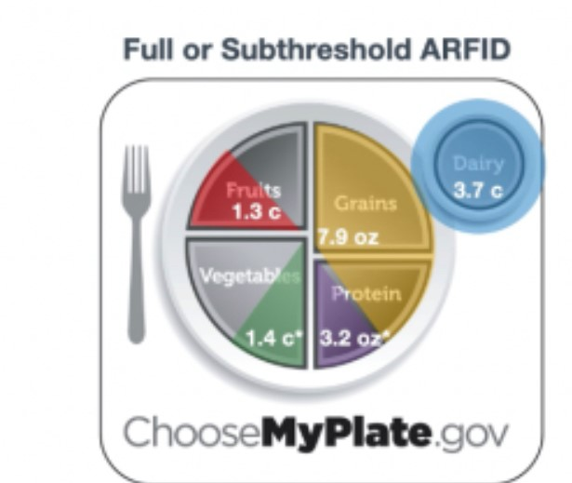
Nutritional Referral
Refeeding as an outpatient
Malnutrition
Later focus on variety
Medical comorbidities with dietary treatment

Slide 44
OUTPATIENT TREATMENT GOALS:
Helping the family
Regular meals, snacks (routine mealtimes)
Weight restoration first if underweight (safe refeeding); then increase variety
Meds for psychiatric comorbidities?
(once refed if low weight especially)
Self-help book (esp for adults)

Slide 45
Manualized Therapy for Youth with ARFID…?
TYPE | TARGETS | EVIDENCE SUMMARY | RECS
FAMILY-BASED TREATMENT (FBT) | Supports parental management of behaviors | Pilot; based on evidence of RCT in other Eds. | USEFUL FOR ARFID
COGNITIVE BEHAVIORAL THERAPY (CBT) | Manage distorted cognitions, fear of eating or new foods | Pilot as well. | May be useful for ARFID
F
AACAP Practice Parameter Eating Disorder May 2015 JAACAP

Slide 46
FBT for ARFID
←FBT Manual (James Lock 2022)
3 phases of FBT; based on FBT-AN
PHASE 1: Parents are tasked with renourishing child. Nutritionist consults to parents.
Weekly sessions with all family members who must be aligned. Family meals
PHASE 2: The child begins to eventually regain some independence..
PHASE 3: Focus is recovery . Returning to developmental norms.
Lock J. et al. 2019 IJED 52(746)
Lock J. et al. 2019 IJED 52:439

Slide 47
Family-Based Treatment
A behavioral “real world” treatment
Parental involvement and empowerment
Educate regarding ambivalence and relapse
Limit setting with patient
Charge parents with structuring mealtimes Consider a treatment contract as needed

Slide 48
FBT (continued)
1. Externalization: The illness is responsible not the child.
2. Focus: Not on causation; focus on symptoms.
3. Caregiver: Responsible for supervising.
4. Monitor: Warning signs for the eating disorder.

Slide 49
CBT-AR (Cognitive Behavioral Therapy)
20-30 sessions over 4 stages
Two forms (individual and family), with individual being best for adult or older adol without much weight to gain). Regular meals with family
Modules depending on the type of ARFID (during stage 3)
Thomas and Eddy 2019 Cambridge Pres

Slide 50
CBT-AR (Continued)
1.Psychoeducation
2. Early changes (increase volume then increase variety)
3. face your fears exposure
4. wrap up/prevention .
Thomas J IJED 53 (10)

Slide 51
What about psychotropic medications?
Little data so far; not RCT. Mainly retrospective case series or reports.
MIRTAZAPINE (Remeron) : SNRI. Little data; case series N=14 (mean dose 25.5 mg daily dose). (Gray 2018)
Cyproheptadine: Antihistamine, increases appetite.
Olanzapine: goal is to decrease early satiety. N=6 cases of SSRI for anxiety augmented by olanzapine (Spettigue2018)
N=9 olanzapine with co-occurring depression or anxiety. Up to max of 2.8 mg +/- 1.47 (Brewerton 2017)
SSRI with or without hydroxyzine may be helpful (study done in PHP) (Mahr F. JCAP Oct 2021)
Treat comorbid psychiatric illness-- keeping in mind
malnutrition status & weight

Slide 52
In sum,
PCPs play an important role to screen for picky eating, and ARFID.
Picky eating trajectory is variable; when it persists may need early intervention.
Establishing medical safety and renourishing the patient is the first step, and then deciding the level of care. (later increase variety as need be).
FBT-AR and CBT-AR manualized treatments are being investigated for use in ARFID. Research ongoing.
Limited evidence for medication use in children; treat
Psychiatric comorbidity.

Slide 53
Thank you!
Questions?

Slide 54
Thank you!
Maryland Behavioral Health Integration in Pediatric Primary Care (BHIPP)
1-855-MD-BHIPP (632-4477)
www.mdbhipp.org
Follow us on Facebook, LinkedIn, and Twitter! @MDBHIPP
For resources related to the COVID-19 pandemic,
please visit us at BHIPP Covid-19 Resources.
Notes:
You will a copy of these slides

