Slide 1
Pediatric Depression: Identification and Treatment in Primary Care Maryland Behavioral Health Integration in Pediatric Primary Care Sarah Edwards, DO Assistant Professor Director and Medical Director Division of Child and Adolescent Psychiatry University of Maryland School of Medicine Carisa Parrish, PhD Associate Professor, Psychiatry & Behavioral Sciences Director of Training, Pediatric Psychology Fellowship Co-Director, Pediatric Medical Psychology Program Johns Hopkins School of Medicine Division of Child & Adolescent Psychiatry
1-855-MD-BHIPP (632-4477)
www.mdbhipp.org
Follow us on Facebook, LinkedIn, and Twitter! @MDBHIPP

Slide 2
Objectives
Understand how to screen and diagnose depression in primary care.
Understand the role of SSRI medication for the treatment of pediatric depression: learn typical dosages, how to initiate, titrate, and taper off antidepressants.
Become familiar with non-pharmacologic treatments of depression.

Slide 3
Mental Health Screening & Depression Management: Integral to Pediatric Primary Care
Why:
Mental health issues are common in children and teens and can portend complex medical and mental disorders in adulthood
8 Million US youth (10%); shortage of C&A Psychiatrists
Why primary care:
Primary care is usually the first and often the only contact that patients have with health care professionals.
Who says so:
Notes:
<8,000 vs 170,000 Pediatric PCCs
AAP: recommends competence in initiating care for children with ADHD, anxiety, depression, and substance use
“…Screen all school aged children … for symptoms of mental illness and impaired psychosocial functioning at health maintenance visits … and when risks or concerns are identified.”
Task Force on Mental Health, Pediatrics June 2010
“The need for primary care clinicians to manage children with mental health concerns only will continue to increase in the future.” AAP website accessed Mar 6, 2011
Adverse Childhood Events (ACE) Correlate with future health outcomes and risk factors for leading causes of death in adults

Slide 4
Pediatric Depression Review

Slide 5
Epidemiology of Childhood Depression
≈5% of children and adolescents in general population suffer from depression at any given time (2% children, 4-8% adolescents)
Male:Female ratio 1:1 during childhood, 1:2 in adolescents
1.7% of children suffer from dysthymia (1.6-8% in adolescents)
Depressive disorders are appearing at a younger age of onset
Notes:
20 % of teens experience clinical depression before adulthood.
10 - 15 % of teens have some symptoms of depression at any one time.
5 % of teens have major depression at any one time
8 % of teens have depression for at least a year
Suicide is the 2nd leading cause of death among teens and young adults
Guidelines for Adolescent Depression in Primary Care (GLAD-PC): Part II. Treatment and Ongoing Management
9% of teenagers meet criteria for
depression at any one time, with as
many as 1 in 5 teenagers having a
history of depression at some point
during adolescence.‍

Slide 6
Depression Presentation in Primary Care
Mood
Depressed and/or irritable
Neurovegetative (Somatic)
Diminished interest or pleasure
Insomnia or hypersomnia
Weight loss or gain
Psychomotor agitation or retardation
Fatigue or loss of energy
Cognitive
Decreased concentration or indecisiveness
Worthlessness or guilt
Suicidal ideation
Notes:
Children with anxiety disorders may present with fear or worry and may not recognize their fear as unreasonable. Commonly they have somatic complaints of headache and stomachache. The crying, irritability, and angry outbursts that often accompany anxiety disorders in youths may be misunderstood as oppositionality or disobedience, when in fact they represent the child's expression of fear or effort to avoid the anxiety-provoking stimulus at any cost. A specific diagnosis is determined by the context of these symptoms.

Slide 8
Major Depressive Disorder Diagnosis DSM V > 5 of 9 sx (must include mood issue) + impaired function
Mood: irritable or depressed +
Sleep: increased or insomnia
Interest: markedly decreased in activities
Guilt: feeling worthless, inappropriate guilt
Energy: fatigue or loss of energy
Concentration: hard to think/concentrate
Appetite: significant wt loss / gain (~ 5% change)
Psychomotor activity: physically slowed or agitated
Suicide: thoughts, attempts, death thoughts

Slide 9
Depression Symptoms

Slide 10
Readily Accessible Screening Tools
Depression
1. PHQ 9 for Teens
2. CES-DC
PHQ 9 + 2 ?’s about suicidality

Slide 11
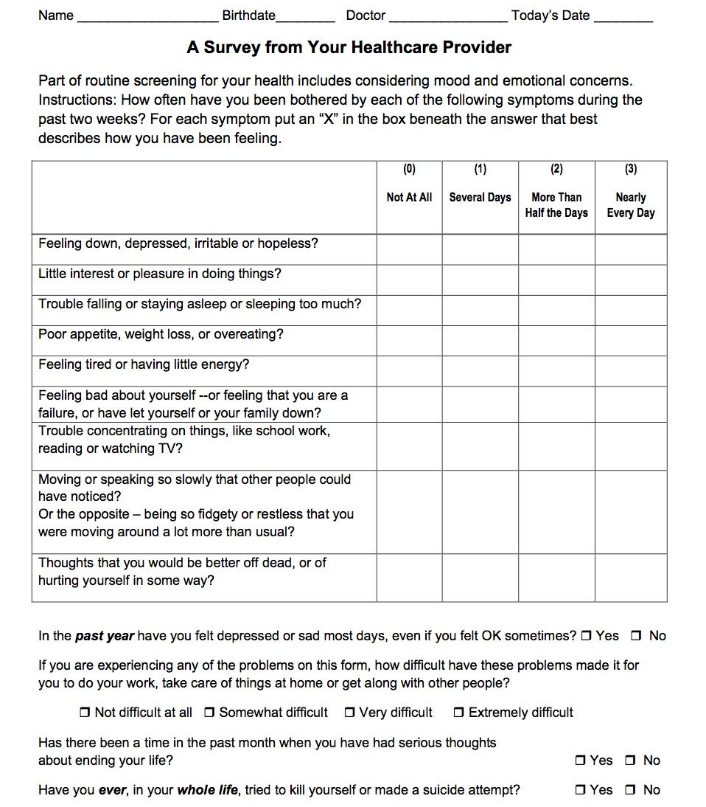
PHQ 9 Modified for Teens
Depression Severity Rating
< 5 None
5 – 9 Mild
10 – 14 Moderate
15 – 19 Mod. Severe
20 + Severe
Impact on Function
Not difficult
Somewhat Difficult
Very difficult
Extremely Difficult
Notes:
Past two weeks
9 Items (from DSM)
Scored--0, 1, 2, 3-- based on days per week symptoms occur
Past year (persistent depressive disorder)
Function: work (school), home, relationships
Suicidal thoughts past month; Suicide attempt ever

Slide 12
Grading Depression Severity Based on Sx and Function (DSM V)
Mild: 5-6 sx of mild severity (including mood) + function mildly impaired or normal but w/ substantial and unusual effort
Moderate: in between mild and severe
Severe: most sx present and severe + function is disabled, clearly observable or psychotic features are present

Slide 13
For 2’s and 3’s (positive symptoms) “Tell me more about….”
Mood…..low…..sad….irritable
Physical symptoms….sleep….energy….appetite….….slow/fast
Diminished interest or pleasure
Cognition…concentration….self worth…..guilt…..never get better….suicidal thoughts
Function……school, home, friends, activities
Course of symptoms over time…..recently…..in past
Who have your shared with?.....family…..friends……their response?
So far, has anything helped?.....therapy…..exercise…..sleep

Slide 14
Screen for Other Mood symptoms and Comorbidities
Physical illness: targeted review of systems, labs
Substance / alcohol use, 20 – 30%
usually follows depression onset by ~ 5 years
Other mood and psychiatric disorders:
Dysthymia, Bipolar Disorder, Anxiety, ADD, PDD, ODD or Conduct Disorders, Psychotic disorders (hallucinations, paranoia)
Abuse: physical / emotional / sexual

Slide 15
John D. Case
John D. back for his annual 12 year check up
Doing well in school
Fighting more with parents and siblings
Mom states he is “moody” and often states he is “just bored” during past 4-8 weeks
No problems is school, but isn’t as “into” soccer like he was which is “strange and not like him”
Wants to play video games all the time
Physical exam normal; in early puberty
COUNSELED ABOUT VIDEO GAMES, PEER RELATIONSHIPS, FAMILY RELATIONSHIPS, PUBERTY
SCREEN FOR MOOD?

Slide 16
John D. Case
PHQ 9 for teens
Scored 6: felt irritable, low energy, and like he was letting his family down. No functional impairment
Mild Depression

Slide 17
Treatment of Mild, Uncomplicated Depression
Active support & monitoring by PCP x 6-8 weeks
See pt weekly or biweekly
Nondirective support (support can be as effective as formal psychotherapy for mild depression)
Monitor depressive symptoms and function (school, home, peer)
If sx persist > 6 – 8 wks, offer psychotherapy and / or antidepressants
Refer patient and family to mental health care providers when appropriate
Notes:
“a period of active support and monitoring (6–8 weeks) using short validated scales before recommending treatment with antidepressants or psychotherapy in cases of mild depression [13]. Evidence from randomized controlled trials (RCTs) show that up to 20 % of depressive youth respond to non-directive supportive therapy, routine specialist care, and/or regular symptom monitoring [13, 22•]. Furthermore, expert opinion and patient/family preferences indicate that active support and monitoring from family physicians is an important therapeutic strategy
17

Slide 18
Initial Management John D. Active Support
Form an alliance w/ the child and affirm hope. Concerns about mood should be acknowledged
Educate, counsel pt and family about depression, management options, limits of confidentiality
Share resources for support: phone #s, websites, handouts
Have family sign release of information form to allow communication w/ school staff, outside providers.
Notes:
Active support and monitoring may include scheduling frequent follow-up visits, encouraging participation in favorite extra-curricular and school activities, referring to a peer support group, setting self-management goals with patients and families, and providing them with educational materials [13]. Other resources for active monitoring can be found in the GLAD-PC toolkit. In addition to its evidence in early mild depression, active support and monitoring in primary care is also essential in cases when adolescents refuse active treatment [13]. More specific psychosocial interventions in primary care can improve depressive symptoms in adolescents, as well as treatment adherence

Slide 19
Depression Psychoeducation

Slide 20
Initial Management John D. Active Support
Assess risk for suicide. Establish a safety plan: restrict access to lethal means, engage 3rd party to monitor for deterioration/risk, develop emergency communication plan to use if needed
Develop a specific tx plan and goals regarding function in home, school and peer relationships
Stress management & lifestyle: Sleep, exercise, weight control, avoid caffeine and alcohol

Slide 21
Psychosocial Treatments for Depression – Sleep
CBT for Insomnia in youth shown some promise but more research needed (e.g., Palermo et al., 2016)
Common components:
Sleep education and sleep hygiene
Keep sleep diary and adjust sleep schedule as needed
Sleep schedule with regular awakening
Sleep restriction (no naps) and caffeine restriction
Stimulus control (lights, electronics etc.)
Notes:
We also know that sleep can be majorly disrupted in youth with depression. There are treatments that have shown some promise (mostly evidence of feasibility and acceptability) but more research is needed to understand their impacts on adolescents

Slide 22
Assessing Suicide Risk
Ask about both ideation and attempts
Have you wished you were dead or you could go to sleep & not wake up?
Have you actually had any thoughts of killing yourself?
Ideation*
Have you made a suicide attempt? Tried to kill yourself?
Done anything to harm yourself?
Anything dangerous where you could have died?
Attempts*
*Adapted from the Columbia Suicide Severity Rating Scale, Posner et al 2009

Slide 23
Safety Plan
Step 1: Warning signs (thoughts, images, mood, situation, behavior) that a crisis may be developing:
Step 2: Internal coping strategies – Things I can do to take my mind off my problems without contacting another person (relaxation technique, physical activity):
Step 3: People and social settings that provide distraction:
Step 4: People whom I can ask for help:
Step 5: Professionals or agencies I can contact during a crisis:
Clinician name and contact info
Suicide Prevention Lifeline Phone: 1-800-273-TALK (8255)
Step 6: Making the environment safe:
The one thing that is most important to me and worth living for is:

Slide 24
John D. Case
Spoke to mother at 2 weeks, John better
8 weeks later, mother calls:
Does not want to wake up in the morning for school
Note from teacher about missed assignment
Outbursts of anger at home and at soccer
Some nights does not sleep at all
PHQ 9 modified score 15 (moderate-severe)
very difficult to function
Not suicidal
Moderate Depression? REFERRAL?

Slide 25
Treatment for Moderate Depression without complicating features
Consider starting antidepressant and recommend
Psychotherapy or refer to Psychiatrist
TADS (Treatment for Adolescents with Depression Study): Higher response rate CBT + Prozac
Notes:
439 teens 13 - 17 y/o with moderate to severe depression
Higher first response rate CBT+ Fluoxetine combined - Improved @ 12 wks: 71% Combo (v. 61% SSRI v. 44% Talk; @ 36 wks: similar outcomes for all groups

Slide 26
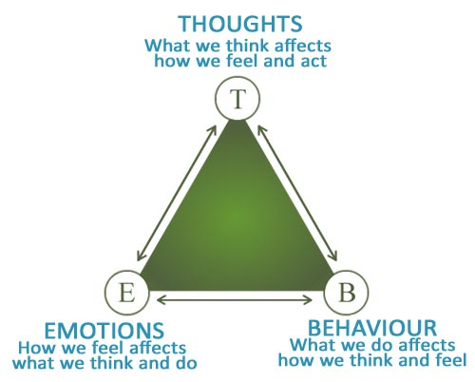
Psychosocial Treatments for Depression – CBT
Common Components:
Behavioral Activation
Problem-solving
Cognitive Restructuring
Homework Assignments
Notes:
American Psychological Association guidelines recommend the use of cognitive-behavioral therapy (CBT) or interpersonal therapy for the initial treatment of depression in adolescents. CBT works by giving youth skills to cope with symptoms like depressed mood, negative or anxious thoughts, or somatic responses. A core point of CBT is helping youth to understand that their thoughts, feelings and behaviors are interrelated and so if we change one we can change all three

Slide 27
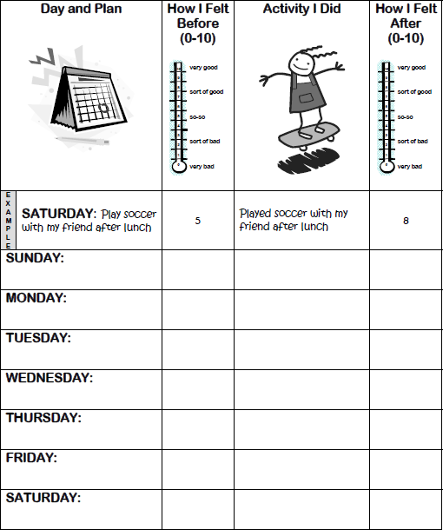
CBT for Depression Components – Behavioral Activation
Engaging in activities linked w/ +mood
4 types of activities improve mood:
youth enjoyed it before
w/ someone they enjoy spending time with
that keep youth busy (e.g., exercise)
that help someone else
Help youth schedule time for activities
Notes:
Behavioral activation involves youth participating in activities and then observing the effect it has on mood. The idea is to get moving and active, so you not only get that physical momentum, but you also start to experience more positive thoughts from having success and interacting more with others.
Behavioral activation helps counter the isolation that people with depression often experience, which can reinforce their depressed mood.

Slide 28
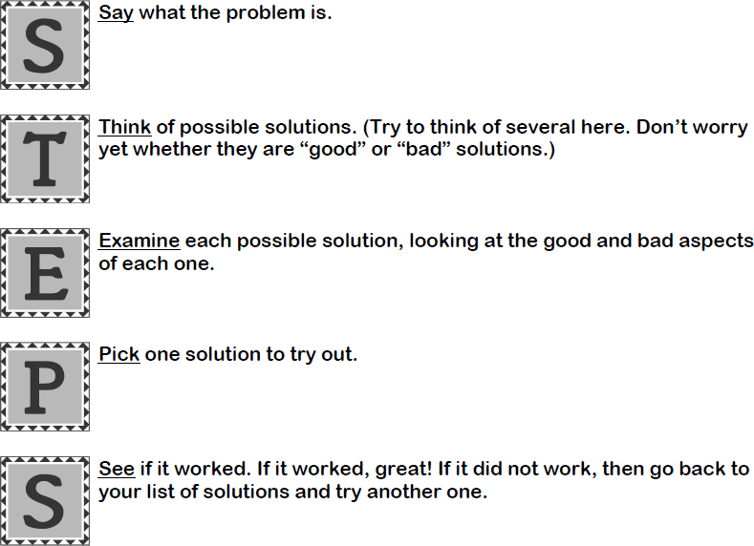
CBT for Depression Components – Problem-Solving Skills
Solving problems can improve mood while not solving them contributes to low mood
Notes:
The second component is Problem-solving skills based on the notion that solving problems can improve mood and doing nothing about ongoing problems can lower mood. The STEPS is just one example of a problem-solving model that can be introduced in therapy.

Slide 29
CBT for Depression Components – Cognitive Restructuring
Identify and change negative thoughts to more realistic thoughts by asking:
What’s the evidence?
Is there another way to look at the situation?
What would you tell a friend who had that thought?
If it is true, would that really be so bad?
Notes:
Another main component of CBT for depression is cognitive restructuring. When youth are in a bad mood they are more likely to have negative thoughts and negative thoughts can also put us in a bad mood so a therapist can help youth to first identify negative thoughts, then challenge them by asking questions like “what’s the evidence, is there another way to look at the situation”
Part of this work is introducing youth to the common negative thinking patterns. Here is one example from John Weisz’s Primary and Secondary Control Enhancement training intervention of common types of negative thoughts:
Blaming myself: Taking too much personal responsibility for negative events (e.g., Its all my fault that we lost the soccer game)
Looking for the bad news: paying attention only to the negative info and ignoring positive info (e.g., focusing on one bad event in a day that was generally fine)
Unhappy guessing: expecting bad outcomes when we don’t really know how things will turn out (“I’m definitely going to fail the test,” “no one will come to my birthday party”)
Exaggerating: Making things seem worse than they really are (I’m not allowed to see my friends today. My life is horrible)

Slide 30
Pediatric Psychopharmacology SSRIs

Slide 31
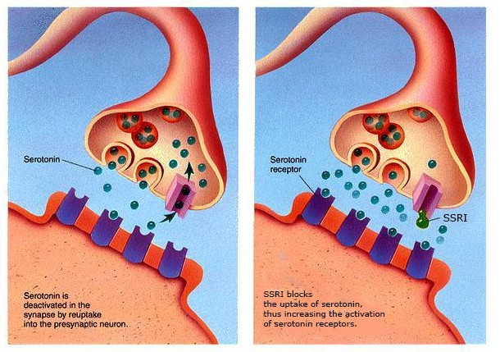
SSRIs: Tier 1 Medications
Fluoxetine (Prozac), Escitapram (Lexapro), Sertaline (Zoloft)
Notes:
Tier 2 meds: Fluvoxaime, Citalopram, Paroxtine, Venlafaxine, Buspiron

Slide 33
Safety Profile
Safety Criteria |  | SSRI | NRI | Stimulant
US FDA approved age, years |  | >8 | >6 | >6
Time on Market |  | >25 | >10 | >50
Overdose harm |  | Very low | Very low | Low
Boxed Warning (major adverse effects) |  | Suicidality | Suicidality | Drug abuse potential
Long-term risk to health |  | None Known | None Known | Possible growth deceleration
Adapted from Pediatric Psychopharmacology for Primary Care; Riddle et al
Notes:
No FDA-approved pediatric indications for anxiety disorder because of a discrepancy between FDS rules regarding anxiety disorder indications and efficacy studies that have been conducted in C&A with anxiety. FDA requires that studies support an application for indication with one focus on a single anxiety disorder. Children anxiety disorders co-occur and change over time. Participants in NIH sponsored studies met criteria for 2 or 3 disorders. Therefore FDA did not use data to support just one indication

Slide 34
SSRIs for Anxiety and Depression
Generic | FDA Indication | Initial Dose Incremental Dose Change | Daily Range Max DD | Available Dose Forms
Fluoxetine (Prozac) | MDD; 8-17 OCD; 7-17 | 5-10 mg Increase 5-10 mg | 10-60 mg daily Max: 60 mg | Capsules: 10, 20, 40 Tablets: 10, 20 Oral: 20mg/5ml
Escitaopram (Lexapro) | MDD; 12-17 | 5-10 mg Increase 5 mg | 10-20 mg daily Max: 20mg | Tablets: 5, 10, 20 Oral: 1mg/ml
Sertraline (Zoloft) | OCD; 6-17 | 12.5-25 mg Increase 12.5-25 mg | 25-200 mg daily Max: 200mg | Tablets: 25, 50, 100 Oral: 20mg/ml

Slide 35
Basic Psychopharm Principles
Psychotropic medications should be prescribed concomitantly with, following inadequate response to, evidence-based therapy
Use FDA approved when possible
Prescribe as few medications as possible simplifies monitoring efficacy and side effects
Sequential changes in medications
Monitoring for safety is just as important as efficacy
Start low, go slow

Slide 36
General Principles
START LOW, GO SLOW…….BUT not too slow…….
Effect size* with comparison to stimulants for ADHD = 1.0
0.7 for anxiety
0.2 for depression (b/o high placebo response rate)
Side effects generally minimal and reversible if SSRI discontinued
4-8 weeks to reach therapeutic dose and maximum benefit
Screening lab: TSH
*Locher C et al, JAMA Psychiatry, 74: 1011-1020; 2017

Slide 37
SSRIs
Onset of Effect: 3-4 weeks at effective dose
Onset of adverse effects (abd pain, etc.) can occur within days of initial dose
Therapeutic effects (improved sleep) may occur before more global improvement in anxiety or mood
Duration of Effect
Continuous as long as medication is taken

Slide 38
Choosing a Medication
No Guidance from AAP or AACAP
Use FDA approved
Other Considerations:
Half-life
Drug-Drug Interactions
Family response
Prozac
Zoloft
Lexapro
Notes:
Prozac 1-4 days; metabolite 7-9 days
Zoloft 26 h
Lexapro 30 hours
Monitor height and weight
No specific laboratory studies are recommended

Slide 39
How to start & titrate SSRIs
Generic | Initial Dose Daily | Incremental Dose Change | Daily Range Max DD | Available Dose Forms
Fluoxetine (Prozac) | 5-10 mg | Increase 5-10 mg | 10-60 mg daily Max: 60 mg | Capsules: 10, 20, 40 Tablets: 10, 20 Oral: 20mg/5ml
Escitaopram (Lexapro) | 5-10 mg | Increase 5 mg | 10-20 mg daily Max: 20mg | Tablets: 5, 10, 20 Oral: 1mg/ml
Sertraline (Zoloft) | 12.5-25 mg | Increase 12.5-25 mg | 25-200 mg daily Max: 200mg | Tablets: 25, 50, 100 Oral: 20mg/ml
Notes:
Need to balance desire to reach therapeutic dose as quickly as possible with reality that an effect of a dose change may not be observable for 2 to 4 weeks. Practical approach to dose escalation that balances this desire and reality is to increase the dose every 4 to 7 days by an amount approximately equivalent to the starting dose while observing for side effects. If no SE, dose increases may continue, as long as there is consistent communication with Pt and PCP. Dose increases can be delayed or reversed depending on clinical situation. Process can continue until optimal dose or max dose is reached.

Slide 40
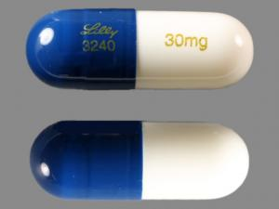
Cymbalta
Generic | Initial Dose | Incremental Dose Change | Daily Range Max DD | Available Dose Forms
Duloxetine Cymbalta) | 20-30 mg daily | Increase 20-30 mg | 30-60 mg daily Max: 120 mg | Capsules: 20, 30, 60
SNRI
FDA approved for 7-17 years for GAD
October 2014

Slide 41
Common Adverse Effects
Nausea
Diarrhea and loose stools
Insomnia
Somnolence
Fatigue
Sexual (decreased libido, ejaculatory delay, anorgasmia)
Sweating increased
Tremor
Agitation

Slide 42
Activation
Many other terms
Implies no specific etiology
Think Benadryl reaction
Common problem shortly after starting medication
Dose related
Reversible
No long term prognostic implications
Notes:
10-15% in clinical trials
Bipolar switching is 1% - true mania, elevated mood, grandiosity, no need for sleep (wake up ready to go)

Slide 43
Safety Monitoring:
1. Contraindications: know hypersensitivity, Serotonin syndrome and MAOIs
Do not use concomitantly
Do not start SSRI within 14 days of stopping MAOI
Do not start Prozac within 5 weeks of stopping MAOI
Do not use concomitantly with Pimozide, Thioridazine
2. Boxed Warning
Suicidal thoughts and behaviors
3. Warning and Precautions:
Serotoninc syndroms, Activation of mania, Abnormal bleeding
Hyponatremia, Changes in appetite and weight

Slide 44
“Black Box” Warning about Antidepressant use in Children and Teens
In 2004, FDA reviewed 23 clinical trials rx’ed any of nine antidepressants for MDD, anxiety, or OCD
Outcomes:
No completed suicides
Pts rx’ed antidepressants reported more suicidality (thoughts & attempts) vs. pts on placebo (4 vs. 2 out of 100).
Suicidality was not induced in pts without suicidality, not increased in pts who already had suicidality
All studies showed reduced suicidality over tx course
More SSRI rx’s associated w/ lower suicide rates
Notes:
Antidepressants increased risk of suicidal thinking and behavior in children, adolescents, and young adults . . . must balance [suicidality] risk with clinical need.

Slide 45
Monitoring Therapeutic Response During Dose Adjustments
During dose adjustment, a weekly phone check-in or appointment is preferred, when possible
Standardized rating scales: PHQ-9 and CES-DC

Slide 46
Follow-up Schedule
First f/u should be a face-to-face meeting w/ MD 1 week after starting medication
If pt is doing well, follow up schedule:
For 1st month: Every week w/ MD or therapist
During 2nd month: Every other week
After second month: Monthly thereafter
If dose is changed, see pt in 2 weeks
See pt sooner for any concerns

Slide 47
Drug Interactions
Drugs that affect homeostasis (NSAIDS, ASA, Warfarin)
MAOIs
SSRIs and trypotophan
Drugs that prolong QT interval (pimozide, thioridazine)
Fluoxetine and sertraline : drugs metabolized by CYP2D6

Slide 48
What if 1st SSRI is ineffective or not tolerated?
Discontinuation of SSRI
Gradual reduction in dose over a few weeks
Do not abruptly discontinue (except Prozac which will “self-taper”)

Slide 49
Switching from one SSRI to another SSRI
TORDIA study: for adolescent depression, if 1st SSRI fails switch to another SSRI
Staggered and overlapping- as long as total daily dose remains equivalent and comparable
Staggered switch can be completed over a few weeks

Slide 50
Example
11yo with depression on Zoloft 100mg x 6 weeks, no adverse effects, no change in mood symptoms, no change sleep/appetite/concentration
Staggered switch:
 | Zoloft (mg) | Prozac (mg)
1-2 weeks | 75 | 5
2-3 weeks | 50 | 10
3-4 weeks | 25 | 15
4-5 weeks | stop | Effective? Or 20

Slide 51
Example
If fluoxetine is abruptly stopped: dose escalation of new SSRI can be based on approximate half-life of fluoxetine of 1-2 weeks
 | Prozac (mg) | Lexapro (mg)
 | 20mg STOP | 2.5
1-2 weeks | Half-life: ~10 | 5
2-3 weeks | Half-life: ~5 | 10
3-4 weeks |  | Effective? 15

Slide 52
How Long to Treat
Meds to decrease the feelings of anxiety and decrease the worries
When ill, kids think that is who they are…
When better, they have to relearn who they are
Sometimes they don’t want to come off
Sometimes providers forget to take them off
It is never “for the rest of their life”
Notes:
Treat until they have complete recovery then I count a year and then I go to the following year

Slide 53
Lashondra Case
The patient is 17-year-old female patient recently diagnosed with depression.
Mom called and reported to the nurse that she expressed suicidal ideation in the context of Prozac titration.
Tell her to stop immediately and go to the emergency room
Call and talk with the patient and her mother to get further details regarding safety concerns/suicidal thoughts
Do nothing, suicidal ideation will likely pass

Slide 54
Safety
You should call and talk with the patient and her mother today to get further details regarding safety concerns/suicidal thoughts.
If she is actively suicidal, engaging in dangerous behaviors, or is unable/unwilling to talk about any dangerous thoughts, have the patient/her mother call 911 or go to the nearest emergency room for an urgent assessment.
If there are no current safety concerns, can monitor in the office tomorrow. Review safety plan, means restriction, increased supervision
It will be important to continue to monitor for suicidal thoughts and discuss safety planning with the patient and the patient’s family including seeing the patient on a weekly basis, or more frequently if necessary

Slide 55
Lashondra Case
She is taking Prozac 20mg to target anxiety and depressive symptoms x 4 weeks.
Helped improved sleep, concentration, and energy. Mood only slightly improved.
Reasonable to continue the medication at this time as long as the patient is being monitored closely for the emergence of suicidal ideation/self-harm (as above).
You may consider a referral to a psychiatrist if you no longer feel comfortable managing this patient.

Slide 56
Duane Case
16-year-old male with a history of anxiety and depression. The patient has become more anxious and activated upon starting Zoloft 25mg daily 1 week ago.
Have the nurse call back and instruct him to stop Zoloft
Tell him to go to the Emergency Department
Bring him into the office to discuss adverse effects of medication, additional stressors that may be contributing to presentation and screening for suicidal ideations
No need to do anything, this happens when you start Zoloft and side effect will go away
Notes:
If there is a concern for activation, you can:
Decrease the amount and slow the titration
Try another SSRI such as switching to Prozac

Slide 57
Duane Case
During the visit you learn that he is having problems falling asleep and sometimes feels “jittery” since starting Zoloft. Denies new stressors and denies safety concerns.
You instruct him to half the dose and stay on 12.5mg and slow the titration
You stop the SSRI because he may have Bipolar Disorder and should not be on antidepressants
You start Ativan 2mg po PRN anxiety
You do nothing since this will go away
Notes:
If there is a concern for activation, you can:
Decrease the amount and slow the titration
Try another SSRI such as switching to Prozac

Slide 58
Maryland Behavioral Health Integration in Pediatric Primary Care (B-HIPP) Components:
Offering support to pediatric primary care providers through free:
Telephone consultation (855-MD-BHIPP)
Resource & referral support
Training & education
Regionally specific social work co-location (Salisbury University and Morgan State University)
Project ECHO®
Direct Telespsychiatry & Telecounseling Services
Care coordination
Notes:
Maryland Behavioral Health Integration in Pediatric Primary Care or BHIPP is a Child Psychiatry Access Program that supports the capacity of primary care providers in Maryland to manage pediatric mental health concerns.
BHIPP offers free behavioral health telephone consultation, resource and referral networking, training and educational opportunities, Web-based longitudinal learning through Project ECHO, telemental health services, care coordination, and social work co-location in select primary care practices in collaboration with Salisbury University (SU) and Morgan State University (MSU).
BHIPP also recently received additional funding to expand warmline consultation services to select hospital Eds, and to provide Technical Assistance to select primary care practices with goal of practices becoming mental health hubs.

Slide 59
Resources
AAP: Addressing Mental Health Issues in Primary Care: A Clinician’s Toolkit
http://www.aap.org/commpeds/dochs/mentalhealth/KeyResources.html
Guidelines for Adolescent Depression in 1⁰ Care: Glad - PC http://www.glad-pc.org
TeenScreen: National Center for Mental Health Checkups
http://www.teenscreen.org/programs/primary-care
NAMI: resources for pts, families, providers http://www.nami.org/

Slide 60
Additional Resources
Chorpita, B. F. (2007). Modular Cognitive-Behavioral Therapy for Childhood Anxiety Disorders. NY: Guilford.
DuPont Spencer, E. DuPont, R., & DuPont, C. (2003). The Anxiety Cure for Kids. New Jersey: Wiley.
Manassis, K. (1996). Keys to Parenting Your Anxious Child. Hauppauge, NY: Barron’s Education Series.
Rapee, R. M., Spence, S. H., Cobham, V., & Wignall, A. (2000). Helping Your Anxious Child. Oakland: New Harbinger Press.

