Slide 1
Supporting Students, Families and Schools as Schools Restart
Samantha Hartley, PhD
National Center for School Mental Health (NCSMH)
BHIPP Resilience Break September 2022
www.schoolmentalhealth.org www.theshapesystem.com

Slide 2
Learning Objectives
– Participants will be able to identify at least 3 behavioral health challenges impacting child and adolescent schooling since the start of the COVID-19 pandemic.
– Participants will be able to identify at least 3 strategies for supporting student behavioral health as they start the 2022- 2023 academic year.
– Participants will be able to identify at least 3 ways to partner with schools to support student behavioral health.
Thank you to Drs. Bohnenkamp, Hoover, and Lever for help developing these slides!

Slide 3
National Center for School Mental Health (NCSMH)
Established in 1995 with funding from the US Department of Health and Human Services (HHS), Health Resources and Services Administration
The NCSMH mission is to strengthen policies and programs in school mental health to improve learning and promote success for America's youth.
Visit the NCSMH website at
www.schoolmentalhealth.org
Notes:
Ok, so let me tell you a bit more about our center. The National Center for School Mental Health at the University of Maryland School of Medicine is funded in part by the Health Resources and Services Administration to lead the National Quality Initiative focused on comprehensive school mental health services.
The NCSMH mission is to strengthen policies and programs in school mental health to improve learning and promote success for America's youth.
The NCSMH focuses on advancing school mental health research, training, policy, and practice at the local, state, and national/federal levels.
We also operate as a community-partnered school mental health organization, providing mental health supports to students throughout several counties in Maryland.
Co-Directed by Sharon Hoover and Nancy Lever. I’m a second year postdoctoral fellow at the Center and completed my predoctoral clinical internship there as well.

Slide 4
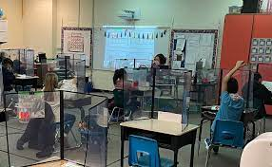
Mental Health is a Simmering Crisis for Many of the Nation’s School Children
“More than 10 months into the pandemic, mental health is a simmering crisis for many of the nation’s schoolchildren, partly hidden by isolation but increasingly evident in the distress of parents, the worries of counselors and an early body of research.”
“Holed up at home, students dwell in the glare of computer screens, missing friends and teachers. Some are failing classes. Some are depressed. Some are part of families reeling with lost jobs, gaps in child care or bills that can’t be paid. Some students care for, or grieve, relatives with covid-19”
Washington Post- January 21, 2021
Notes:
First I want to ground us in our national picture for our school communities. Although the immediate signs of a pandemic may not be as visible when we go into schools – there are far fewer masks and test kits – students, families, and educators are often still feeling the impact of the last two years.
This article from the Wash post came out in Jan of last year and resonated with me. Mental Health is a simmering crisis for many of the nations school children, increasingly evident in the distress of parents, the worries of counselors and an early body of research. And I can imagine for many of you, you had similar evidence, in your experience.
In the context of tremendous stress, loss, and community and family burden, it is not surprising that we would see an impact on young people’s mental health. We know these impacts cut across all communities, and may be most impacting communities hit hardest by COVID including our communities of color and those with inequitable access to healthcare and education.
And even as we come out of this dark time, the after effects are great.
We have to consider a developmental perspective when we think about this- that a year or two spent this way as adults, is much different than a key year of development. What would it have meant to have your Kindergarten, 6th 9th grade year altered in such a significant way.

Slide 5
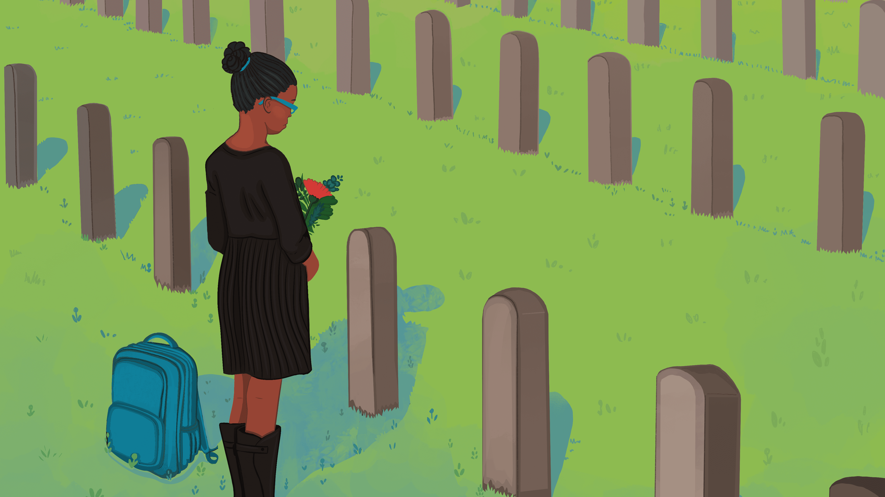
Notes:
Many of our students are dealing with the loss of a caregiver or other important adult in their life – a recent research letter published in JAMA Pediatrics (https://jamanetwork.com/journals/jamapediatrics/fullarticle/2795650) estimates that about 250k children in the US lost a caregiver to COVID. For these students, it can be challenging to see their peers/schools return to something close to normal when their lives have been so changed.

Slide 6
Notes:
Students have become keenly aware of race-based inequities that were highlighted during the pandemic, as well as the often dehumanizing and hateful rhetoric surrounding the recognition of bias in institutions, crumbling infrastructure, community violence, and embrasure of white supremacy.

Slide 7
Notes:
A return to school has also meant a return to school shooting drills, with Uvalde serving as a particularly heartbreaking reminder that schools aren’t always a safe place to be.

Slide 8
Mental health challenges are rising
Mental health-related emergency department visits are up
24% for children (age 5-11) and 31% for youth (age 12-17).
Twenty-two percent of parents report their child’s mental health or emotional health is worse than before the pandemic.
https://www.cdc.gov/mmwr/volumes/69/wr/mm6945a3.htm https://www.cdc.gov/mmwr/volumes/70/wr/mm7011a1.htm?s_cid=mm7011a1_w

Slide 9
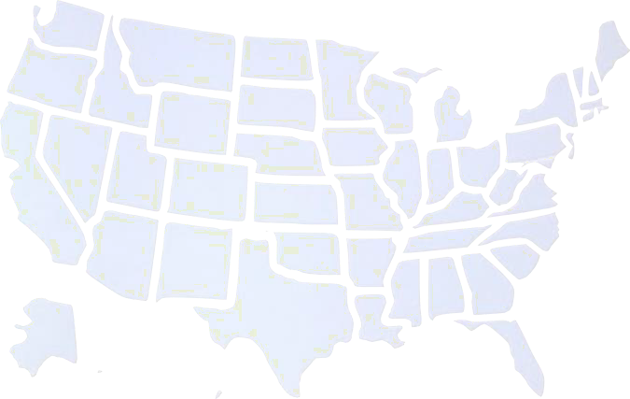
National Tr
Past pandemics were associated with increases in depression, anxiety, stigma, and shaming.
Longitudinal negative impacts of other large-scale community crises (e.g., natural disasters) on children’s behavioral health and academic functioning.
Citations:
Moukaddam, N. Fears, outbreaks, and pandemics: Lessons learned. Psychiatric Times. November 15, 2019. Epub ahead of print.
Osofsky, J. Kronenberg, M. Bocknek, E., Hansel, T.C. (2015, August). Longitudinal impact of attachment-related risk and exposure to trauma among young children after hurricane Katrina. In Child & Youth Care Forum. 44(44), 493-510. Springer US.
Ward, M.E. Shelley, K. & Pane, J.F. (2008). Hurricane Katrina: A longitudinal study of the achievement and behavior of displaced students. Journal of Education for Students Placed at Risk. 13(2-3), 297-317.
17

Slide 10
National Trends: Students
In a nationally representative survey of young people aged 13-19:
Approximately 25% felt disconnected from peers and adults.
More than 1 in 4 reported:
increase in sleep loss due to worry
feeling unhappy or depressed
feeling constantly under strain
loss of confidence in themselves
Citation: https://www.americaspromise.org/sites/default/files/d8/YouthDuringCOVID_FINAL%20%281%29.pdf
10
Notes:
Want to share the numbers here- that we have this significant impact nationally
Early in the pandemic, surveys of young people provided some insight into the mental health status and experience of young people.
Many young people felt disconnected from peers and adults
And more than a quarter reported an increase in sleep loss due to worry, feeling unhappy or depressed, feeling constantly under strain, and loss of confidence in themselves

Slide 11
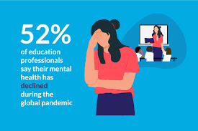
Educator Mental Health and Well-Being
Pre-pandemic
2/3 of educators usually feel stressed out (2x more than general population)
58% of educators- 7 or more days of poor mental health in past month
After 2 years of the pandemic:
1 in 3 teachers indicated the pandemic has made them more likely to leave teaching.
73% of teachers report frequent job-related stress
80% report spending more time addressing students’ mental health
Notes:
Jill
First I want to share dire stats from before the pandemic: read both
In a survey conducted last summer by the National Board for Professional Teaching Standards, the vast majority of teachers reported working longer hours following school building closures and only 28% said their school offered adequate support for mental health.
52% of teachers said their mental health declined during the global pandemic.
This is particularly important when it comes to teacher retention.
Last August, a national survey found that one in three teachers indicated the pandemic has made them more likely to leave teaching.
And this year we are not hearing relief from educators, instead we are hearing that this year is just as hard if not harder than last year with the compounded effects of two years of the pandemic, without any break, taking a significant toll on our educators
I know you are living these statistics but I share them to highlight that this is the case nationally- you are not alone in these numbers
Teaching Under COVID-19: Perspectives from National Board-Certified Teachers
https://www.nea.org/advocating-for-change/new-from-nea/safety-concerns-over-covid-19-driving-some-educators-out

Slide 12
Teacher Stress Impacts Students
When teachers are highly stressed
Students show lower levels of social adjustment
Lower student academic performance
More student behavior problems
Classrooms led by a teacher who reported feeling overwhelmed (high burnout) had students with much higher cortisol levels.
Teacher Stress
Student Misbehavior
Teacher Stress
Greenberg, Brown, & Abenavoli (2016)
:
Oberle & Schonert-Reichl (2016).
12
Notes:
Careful with wording making teachers sound secondary. Teacher burnout and student cortisol
First part Greenberg, M. T., Brown J. L., Abenavoli, R.M. (2016). “Teacher Stress and Health Effects on Teachers, Students, and Schools.” Edna Bennett Pierce Prevention Research Center, Pennsylvania State University.
file:///C:/Users/KScardamalia/Downloads/rwjf430428%20(1).pdf
assessed cortisol levels of ~ 400 children and Burnout of their Teachers
We know stress can take several forms – you have heard terms lately like burnout or compassion fatigue
Wellbeing to counteract the stress

Slide 13
Behavioral health challenges impacting child and adolescent schooling during COVID-19

Slide 14
Stressors Related to COVID-19 ANXIETY/FEAR/STRESS
Increased challenges with mental health issues (e.g. anxiety, depression)
Confusion and uncertainty about what will happen next
Worry and fear for the safety of self and others (for teachers, worry about their students)
Anxiety related to unknowns, new ways of operating in schools
Fears associated with re-opening schools and COVID-19 transmission
Unsafe situations at home (e.g., abuse, neglect, domestic violence)
Citation: National Center for Safe Supportive Learning Environments, 2020
14

Slide 15
Stressors Related to COVID-19 LOSS
Loss of resources (e.g., extended family support, job loss, access to mental health services and health care)
Loss of family members, community members, teachers, and students
Students and staff missing out on important rituals and transitions (e.g., prom, graduation, end-of-year celebrations and goodbyes, losses)
Sudden disruption of normal routines, relationships, structures, and predictability
Food and housing insecurity
Citation: National Center for Safe Supportive Learning Environments, 2020
15

Slide 16
Stressors Related to COVID-19 EQUITY
The disproportionate effects of COVID-19 in communities of color and increased risk for these and other stressors
Disproportionate access to virtual education for students
(e.g., technology, learning challenges)
Continuing impacts of financial stress (e.g., housing instability, food insecurity, inflation, disability) disproportionately impact low-income communities
Citation: National Center for Safe Supportive Learning Environments, 2020
16

Slide 17
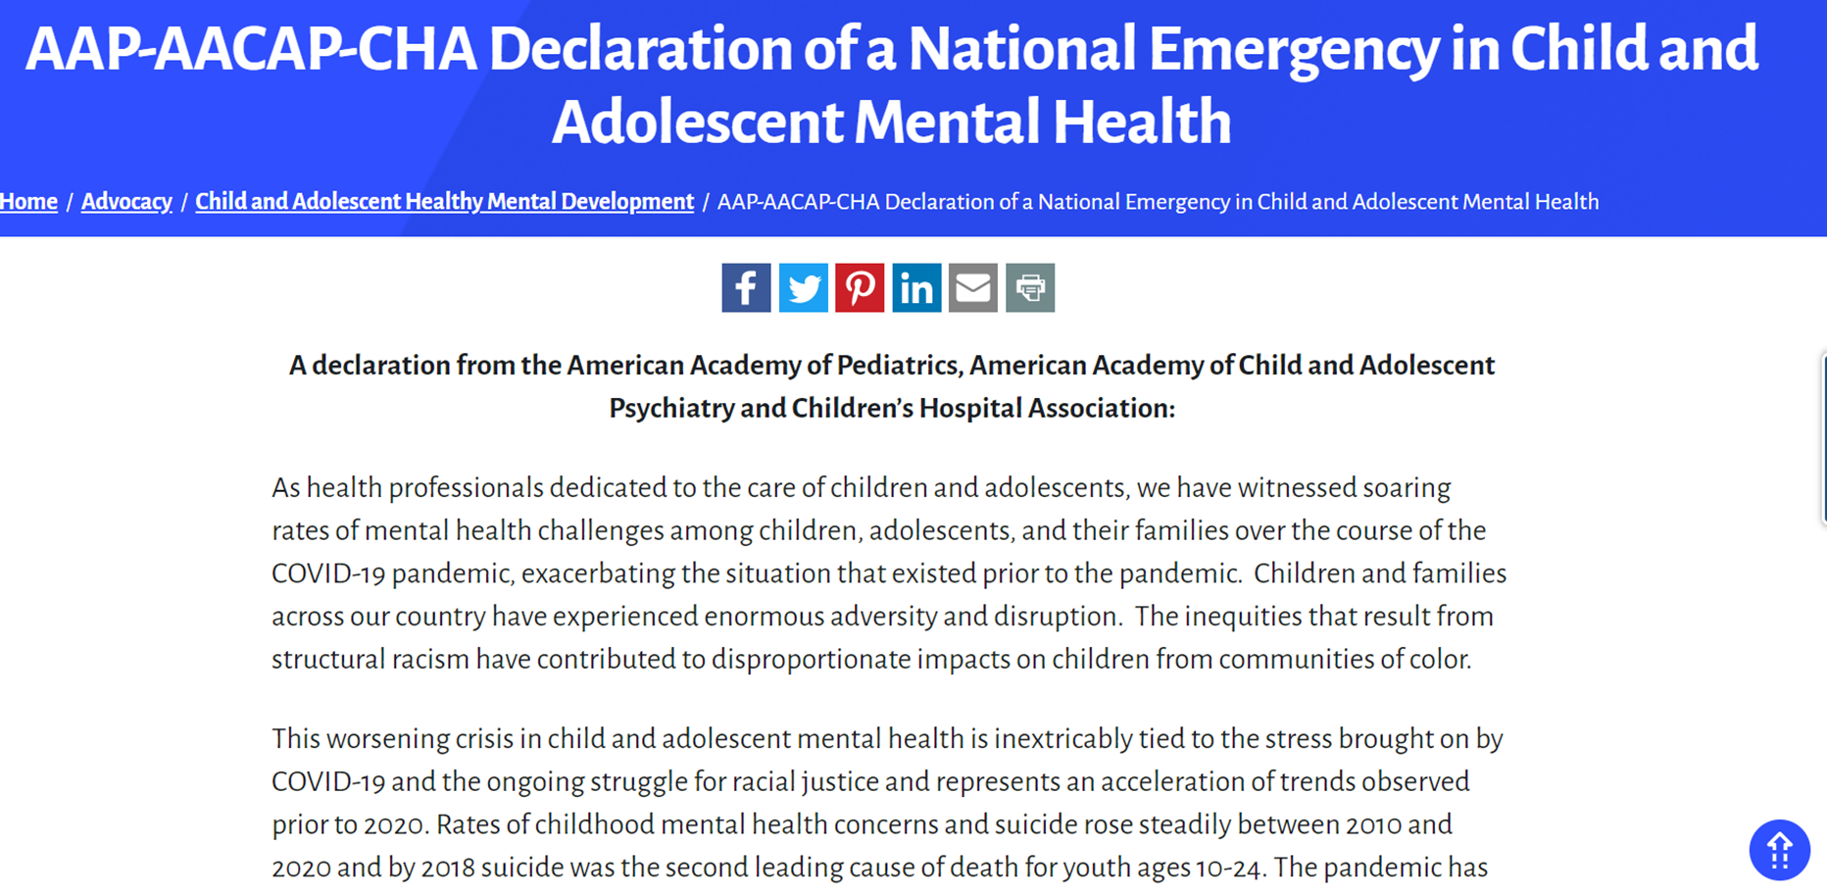
Notes:
And our education and health leadership recognize this as well. AAP declared a nat emergency and U.S. Sec of Ed highlighted that school mental health is a national priority
Released Tuesday, October 19, 2021
Adversity and disruption during COVID is exacerbating a situation that occurred prior to COVID
Depression and suicide rates were already soaring for youth with disproportionate impacts for youth of color
In the context of tremendous stress, loss, and community and family burden, it is not surprising that we would see an impact on young people’s mental health.
We know these impacts cut across all communities, and may be most impacting communities hit hardest by COVID including our communities of color and those with inequitable access to healthcare and education.

Slide 18
Perhaps the most potent element of all, in an effective crisis service system, is relationships.
To be human. To be compassionate.
We know from experience that immediate access to help, hope and healing saves lives.
~ SAMHSA 2020,
National Guidelines for Behavioral Health Crisis Care
Best Practice Toolkit
Notes:
Quote
I found this quite poignant as we consider the crises we are facing as a nation – both COVID and the rampant injustices of racism that are not new but are seeing a new day of awareness and uprising that creates and opportunity for change.

Slide 19
Strategies schools can offer to support student behavioral health

Slide 20
Comprehensive school mental health systems
Provide an array of supports and services that
Positive School Climate
Social Emotional Learning
Mental Health & Well-being
Prevalence & Severity of mental Illness
These systems are built on a strong foundation of district and school professionals, including:
Administrators
Educators
Specialized Instructional Support Personnel
All in strategic partnership with students, families and
community health &mental health partners
Notes:
When we talk about comprehensive school mental health systems, what do we mean?
CSMH systems provide an array of supports and services that promote positive school climate, social and emotional learning, and mental health and well-being, while reducing the prevalence and severity of mental illness.
These systems are built on a strong foundation of district and school professionals, including administrators, educators and specialized instructional support personnel (e.g., school psychologists, school social workers, school counselors, school nurses and other school health professionals),
all in strategic partnership with students and families, as well as community health and mental health partners.” Hoover et al., 2019

Slide 21
Notes:
Multi-tiered systems of support is a term used both when talking about academics in school but also when talking about social, emotional and behavioral well-being. It is rooted in a public health approach to triaging supports based on needs.
So at the foundation is the climate within which schools exist:
This includes having strong partnerships with families and with the community
Having a school workforce that is not only trained but is supported in their capacity to do the work
Tier one: (80%) promotion of healthy behaviors and all over wellness. An example of this may be a universal social emotional learning program that is used in the school to promote healthy social behaviors and expression of emotions
Tier two: (15%) early intervention for students who are at risk for mental health concerns. Groups for managing emotions or targeted classroom lessons on problem solving etc
Tier three: targeted interventions for student who are either at significant risk or have a diagnosable mental health concern. This may look more like individual counseling, in-classroom supports, partnering with medical professionals etc.

Slide 22
Figure 4. An Example of Complementary Roles and Resources of Community Partners and School Districts in Comprehensive School Mental Health Systems
Notes:
When partnering w/ outside partners, the triangle flips. Schools are often equipped and trained to support students at the tier 1 level and may not need as much support. Where school personnel are less trained are to work w/ students w/ more significant mental health concerns. So when bringing in outside partners, partners may focus on the indicated services and supports, supporting students at an individual level with more targeted and focused interventions.
Give example of SMHP program

Slide 23
UNIVERSAL Strategies
Supportive, inclusive, positive school climate
TF-CBT
Culturally responsive policies and practices
Tier III. Few Students
Apparent behavioral
health needs
Bounce Back (K–5) CBITS (6–12)
Trauma responsive policies and practices
Tier II. Some Students
At risk for behavioral
health concerns
SSET
Staff wellness
STRONG
PFA/PREPaRE
Tier I. All Students
Regardless of behavioral health risk
SEL
MH LIteracy Staff Wellness
Social Emotional Learning (SEL)
Crisis preparedness
Mental health literacy for school staff and students
School-wide ecological strategies

Slide 24
What Kids Need (age doesn’t matter)
To feel loved and protected
To understand
To know their feelings
To feel capable

Slide 25
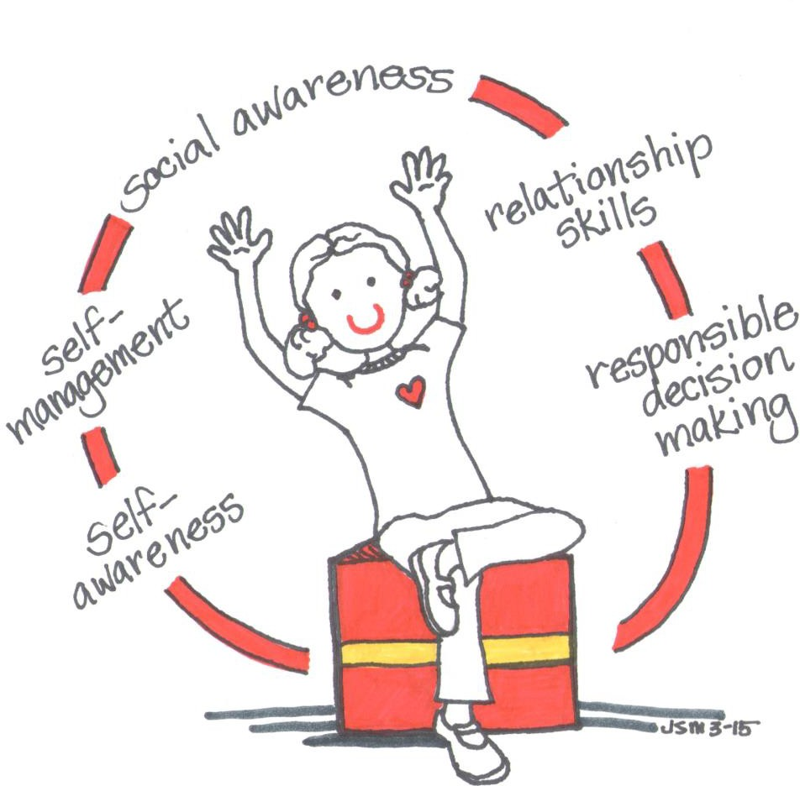
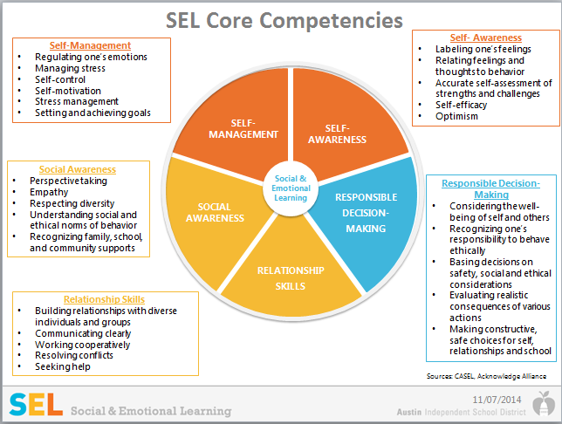
Social and Emotional Strategies

Slide 26
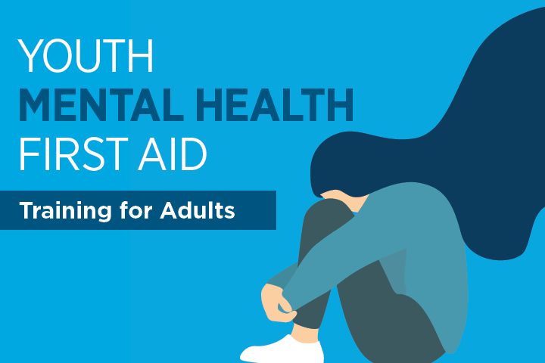
Adult Gatekeeper Training
PSYCHOLOGICAL FIRST AID:
Listen Protect Connect/Model and Teach
https://www.ready.gov/sites/default/files/documents/files/PFA_SchoolCrisis.pdf

Slide 27
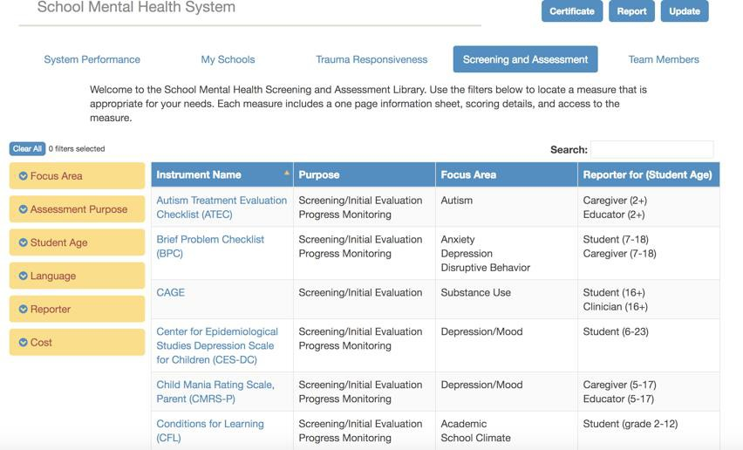
Screening in Schools
Impact of COVID-19
COVID-19 Adolescent Symptom & Psychological Experience Questionnaire (CASPE)
Epidemic Pandemic Impacts Inventory (EPII)
DERS for Coronavirus Pandemic
Coronavirus Impact Scale
Life Satisfaction/Subjective Well-being
Psychological distress/Symptomatology
Positive Functioning
School Factors
Social Determinants of Health

Slide 28
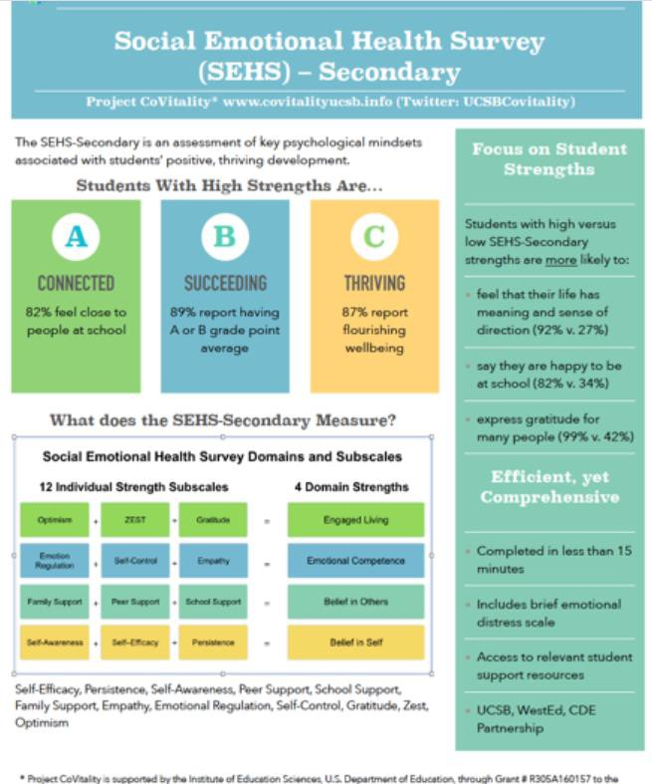
Screen for strengths https://www.covitalityucsb.info/
and consider trauma-informed assessment: https://csch.uconn.edu/wp- content/uploads/sites/2206/202 0/06/CSCH-Report-Responding- to-COVID-19-Planning-for- Trauma-Informed-Assessment-in- Schools-Final-June-2020.pdf

Slide 29
Early Intervention and Treatment in Schools
Evidence-based psychosocial interventions – e.g., CBITS/Bounce Back, TF- CBT
Psychiatric care
TF-CBT
Tier III. Few Students
Apparent behavioral
health needs
Tier II. Some Students
At risk for behavioral
health concerns
Bounce Back (K–5) CBITS (6–12)
SSET
STRONG
PFA/PREPaRE SEL
MH LIteracy Staff Wellness
Tier I. All Students
Regardless of behavioral health risk
School-wide ecological strategies
1. Realize 2. Recognize 3. Respond 4. Resist
Sharon Hoover, 2018

Slide 30
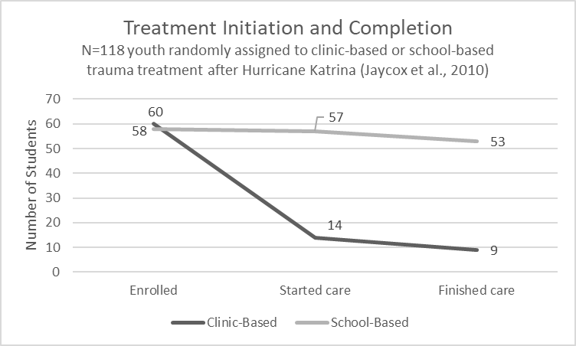
Why Mental Health Treatment in Schools?
Youth are 6x more likely to complete mental health treatment in schools than in community settings (Jaycox et al., 2010)

Slide 31
CBITS developed to help children in schools cope with trauma

Slide 32
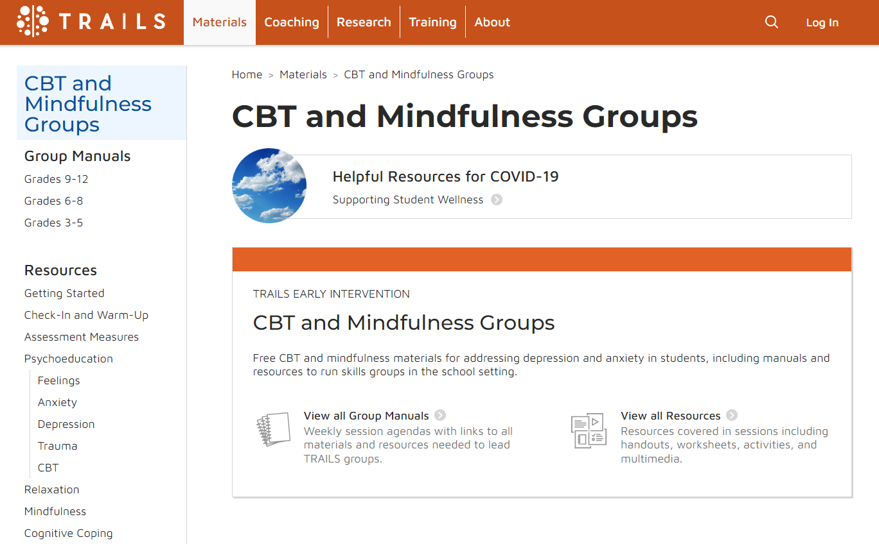
Trails to Wellness Group Materials

Slide 33
Partnering with Schools to Support Student Behavioral Health
Universal supports Patient-specific supports

Slide 34
Universal Supports
Support teachers
Consultation on how to identify behavioral health concerns, conduct screening, and triage students to appropriate levels of care
Host a virtual “Ask a Doctor” session for parents
Provide a list of mental health providers and child/adolescent psychiatrists in the
community
Search for clinicians who specialize in child/adolescent and family therapy
Indicate which insurance plans providers accept
Determine the length of wait lists
Create "quick guides" with indicators of mental health difficulties (e.g., anxiety and
depressive symptoms), discuss potential screening options, and how to access services
within the school or local community

Slide 35
Questions to ask local districts/schools of patients:
What resources and supports will they offer for students' social, emotional, and behavioral well-being?
Does the school have a social-emotional learning program or strategies to engage all students around well-being and mental health? Do you screen students for mental health concerns?
Are there mental health providers within the school? Will they have the capacity to work with general education students? How will students and families access these services?
If there isn’t school-based capacity to see new students, is there a list of community mental health providers they provide to parents?
What can I/my office do to help support your SMH efforts? Are there opportunities for us to combine efforts to support youth and families?
How can I/my office better connect with your school team? Are there any opportunities that I could join to learn more about your work to support student and family health and well-being?
Notes:
If you are looking to partner with a school or district, here are some questions to consider asking to get the process started.
A school may have already conducted a needs assessment and know where need is or maybe that is something that they could use your advice on, what are common concerns that you see presenting at your office.

Slide 36
Resource for Supporting Teacher Well-Being: https://www.medstarwise.org/resources
Weblink to Workbook

Slide 37
Patient-specific supports
Support re-establishing routines and social connections
Create a proactive coping plan for students
Provide education about sleep hygiene, social media use/screen time, and signs of mental health difficulties
Coach caregivers in how to communicate with their child when they’re concerned about their mental health
Encourage families to connect with SMH supports; explain the role of a release of information form so you can connect with their clinician
Communicate with school personnel about student progress/concerns
Screen students and families for general well-being and COVID impact

Slide 38
C
Back to Basics:
Routines can help everyone stay in
touch and reduce stress. If the ones
you have in place are working, stick to
them, if not create new ones for this
special time.
Basic hygiene routines: brush teeth,
change out of pajamas, hair
Sleep routines. Sleep schedules may have shifted during the summer
(especially for teens!). Review sleep
hygiene principles, troubleshoot
common causes for late bedtimes, and establish a bedtime routine.

Slide 39
Proactive Coping Plan
Before school gets overly stressful, have kids think about how they’ll take care of themself.
Write down:
The people they can reach out to for support.
The things they do that make them feel better and improve their mood. How can they remember to do these things?
The things they do that make them feel worse and darken their mood.
The things they do in the moment that they want to believe make them feel better, but actually end up making them feel worse.
What to do if they need additional help.

Slide 40
Behavioral Activation
Staying “SAFE”
Social
call friends, play
games with family
Active
dance, walk/run/ride bikes, do YouTube exercises
Fun
choose an activity you enjoy- read, puzzles, board games
Effortful
chores, schoolwork, make dinner, clean

Slide 41
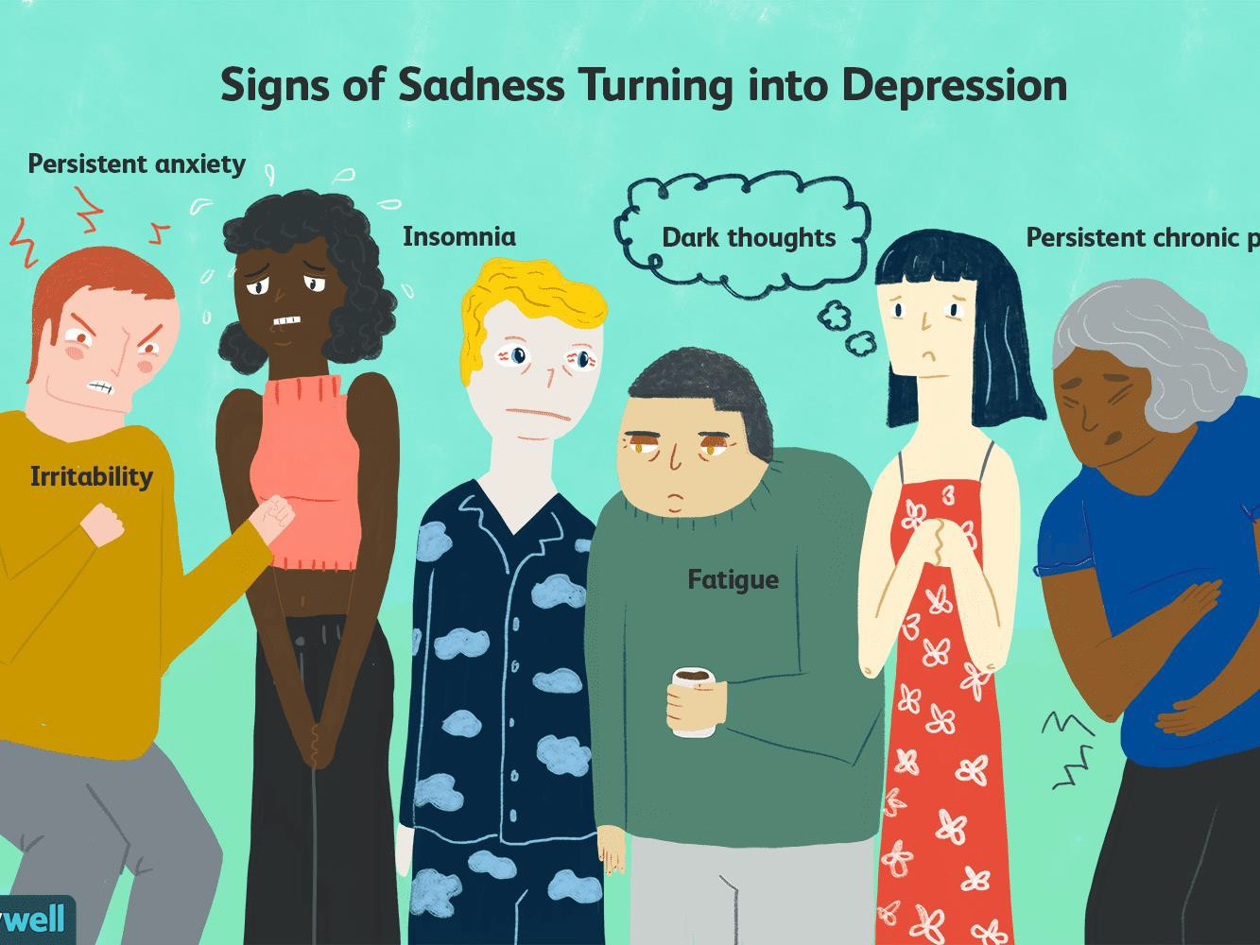
Is this a normal reaction to COVID or is it more?

Slide 42
Warning Signs for Depression
Social withdrawal;
isolation
High emotional reactivity /anger to limits /expectations
Increase self criticism and overaction to criticism
Drop-in activities, loss
of interest
Talking about death, interest in death, wanting to be dead
Increased tendency
to shut down

Slide 43
How to Ask About Mood
Chose the right time
Do not engage immediately after an argument/disagreement or when in the middle of fun task
Stick to the facts
Tell them specific behaviors you find concerning, ask if they have noticed behaviors
Validate
Let them know how hard things have been lately, express concern for their well-being
Self-disclose
Sharing can be a powerful tool
Ready for push-back
Conversation may go poorly or not

Slide 44
Screening questions to ask patients/families
Since COVID and school closures:
What has been the most difficult for your family?
What positive opportunities, if any, have arisen for your family?
Have any of your family or community members become ill or died from COVID?
Have you had any job loss or financial loss?
Have you had any trouble with food or housing?
How will your child be returning to school?
(If they were in-person last year) How did your child deal with the transition back to in-person school?
How do you/your child feel about this year’s school plan? Do you have any specific
concerns? Anything you are looking forward to?

Slide 45
Screeners to incorporate in visits
Pediatric Symptoms Checklist (PSC- 17)-General Emotional and Behavioral Concerns
Strengths and Difficulties Questionnaire (SDQ)-General Emotional and Behavioral Concerns, includes assessment of strengths
Behavioral Health Checklist (BHCL)
Patient Health Questionnaire- Modified for Teen (PHQ-9-M)- Brief Depression Screener for Adolescents
Notes:
BHCL – screens for anxiety, depression, disruptive behavior, ADHD, subscale to evaluate strengths/indicators of resilience

Slide 46
To address concerns from screener:
H | Hope: for improvement, identify strengths
E | Empathy: listen attentively
L² | Language: use family’s language, check understanding Loyalty: express support and commitment
P³ | Permission: ask permission to explore sensitive subjects, offer advice Partnership: identify and overcome barriers Plan: establish plan or at least a first step that a family can do
Adapted from American Academy of Pediatrics. Addressing Mental Health Concerns in Primary Care: A Clinician’s Toolkit. Elk Grove Village, IL: American Academy of Pediatrics; 2010. Updated May 2017.
Notes:
Use recommended Common Factors model from the AAP
“Wow…I’m impressed that you’ve really been managing a lot. What do you think is the most important thing to tackle next?”
“What one thing could we work on that would help you feel better right away?
These statements illustrate the common factors approach—providing encouragement, hope, and support and amplifying what’s important from the patient’s lens. By helping patients and families break down complex problems down into smaller steps, big problems feel more manageable.

Slide 47
Connect with NCSMH
www.schoolmentalhealth.org
www.theshapesystem.com
facebook.com/centerforschoolmentalhealth
@NCSMHtweets

