Slide 1
Involving families in youth SUD treatment October 26th, 2022 12:30 – 2:00 PM Marc Fishman MD
855-MD-BHIPP (632-4477)​
www.mdbhipp.org​
855-337-MACS (6227)​
www.MarylandMACS.org

Slide 2
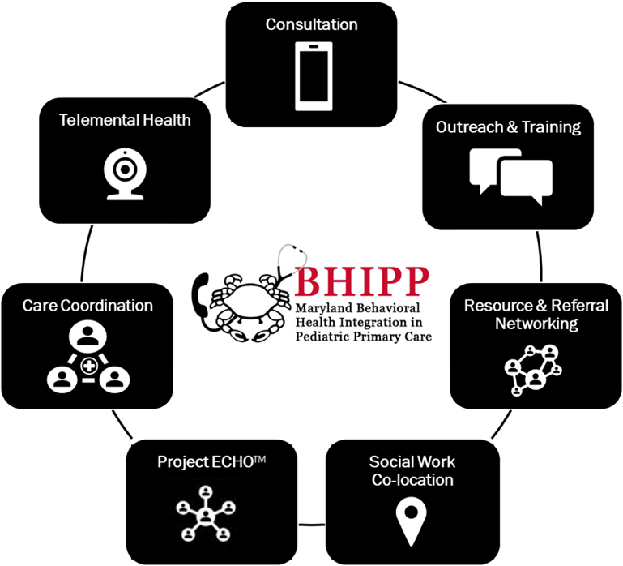
Who We Are – Maryland BHIPP
Offering support to pediatric primary care providers through free:
Telephone consultation (855-MD-BHIPP)
Resource & referral support
Training & education
Regionally specific social work co-location (Salisbury University and Morgan State University)
Project ECHO®
Coming soon!
Direct Telespsychiatry & Telecounseling Services
Care coordination
Notes:
Maryland Behavioral Health Integration in Pediatric Primary Care or BHIPP is a Child Psychiatry Access Program that supports the capacity of primary care providers in Maryland to manage pediatric mental health concerns. We do this, currently, in a number of ways: 1. We offer a free behavioral health telephone consultation service, including resource and referral support, 2. education and training, 3. Through our partnership with Salisbury and Morgan State University, we offer co-location of social work interns at select primary care sites, 4. Web-based longitudinal learning through Project ECHO similar to today’s event, 5. Direct telepsychiatry and telecounseling services (coming soon) , 6. Care Coordination (coming soon)

Slide 3
Partners & Funding
BHIPP is supported by funding from the Maryland Department of Health, Behavioral Health Administration and operates as a collaboration between the University of Maryland School of Medicine, the Johns Hopkins University School of Medicine, Salisbury University and Morgan State University.
This program is supported by the Health Resources and Services Administration (HRSA) of the U.S. Department of Health and Human Services (HHS) as part of an award totaling $433,296 with approximately 20% financed by non-governmental sources. The contents of this presentation are those of the author(s) and do not necessarily represent the official views of, nor an endorsement, by HRSA, HHS or the U.S. Government. For more information, visit www.hrsa.gov.

Slide 4
Maryland Addiction Consultation Service (MACS)
Provides support to prescribers and their practices in addressing the needs of their patients with substance use disorders and chronic pain management.
All Services are FREE
Phone consultation for clinical questions
Education and training opportunities related to substance use disorders and chronic pain management
Assistance with addiction and behavioral health resources and referrals
Technical assistance to practices implementing or expanding office-based addiction treatment services
MACS TeleECHO™ Clinics: collaborative medical education through didactic presentations and case-based learning
1-855-337-MACS (6227) • www.marylandMACS.org

Slide 5
Disclosures
Consultant for Alkermes, Drug Delivery LLC, ASAM, National Assoc Drug Court Professionals
Research funding from Alkermes, NIDA, Arnold Foundation, University of MD

Slide 6
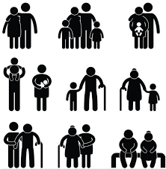
Treatment of OUD in Youth: (YORS) Intervention
Involving families in youth SUD treatment
Marc Fishman MD
Maryland Treatment Centers
Johns Hopkins University School of Medicine

Slide 7
Outline
Barriers to family engagement
Rationale for family engagement
Basics of family engagement
Examples of family engagement treatment intervention:
Community reinforcement approach and family training (CRAFT)
Network Therapy
Youth Opioid Recovery Support (YORS)

Slide 8
Barriers to Family Engagement

Slide 9
Family Engagement:
Historical Barriers
Normative pushback against sense of parental and family dependence, intrusion and restriction
Clinicians: lack of training, competence, comfort
Focus on internal transformation
Preoccupying focus on “enabling”
Over-rigid concern with confidentiality
Stigma of SUD

Slide 10
Patient perspective on family involvement
They don’t understand
This is my treatment, it’s none of their business
They just get crazy, angry, critical, punitive
They just assume I’m guilty
I don’t want to be treated like a child
You can’t talk to my family
I know my rights

Slide 11
Family/parent perspective on family involvement
I’m boxed out of my loved one’s treatment and have no input
I can’t even get any info
Treatment professionals tell me I have to
Let go
Stop enabling, use tough love
Respect boundaries (whatever that means)
Stop rescuing (but they could die..)

Slide 12
Counselor perspective on family involvement
Patient is being sneaky and devious
Family is being overbearing and ineffective
The regulations tie my hands

Slide 13
Rationale for Family Engagement

Slide 14
Case Vignette
17 M living with parents, HS student, daily cannabis, escalation of binge alcohol, recent initiation of opioids
There’s nothing wrong with weed; They treat me like a child; They’re always screaming at me I’d just as soon live on the street
He doesn’t get it; if he does these things he’ll never get anywhere; he lies and steals
Let’s begin a process of discussion and negotiation – parents you can set rewards/consequences for behavior, patient you can set goals for rewards
Parents: we don’t have time for this, we can’t stop driving him then he wouldn’t go to school, we can’t take away his phone then we won’t know where he is, he says he’ll run away, what’s the point he doesn’t listen we’ll just throw him out
Patient: I don’t want to meet with them they don’t need to know my business, they’ll never give me rewards unless I’m “perfect” which I will never be, what’s the point they’ll just throw me out

Slide 15
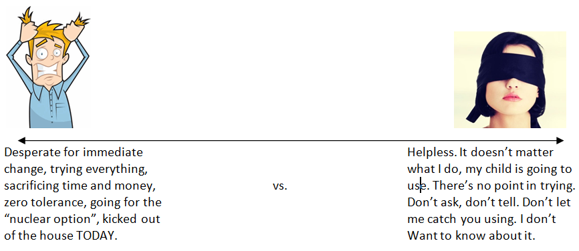
Can families find a balance?
Notes:
When parents are concerned about addiction, they may experience a sense of emergency- that everything needs to change NOW. They might desperately try to get their child into a treatment facility, spending money and time in an effort to “fix” the problem. They may become overly suspicious, frantically watching their child’s every move to make sure they stay on track. They may get into repeated confrontations and battles, trying to force their child into better behavior.
When parents’ best efforts do not work to keep their child healthy, it is common to experience a sense of helplessness. Some parents feel as though nothing they do or say will make a difference anymore. In fact, parents might feel so helpless that they close their eyes to (or minimize) their child’s use, preferring not to see the painful reality. They might say thing’s like– “you’re a grown adult, you figure it out”. Most times, when a parent ignores warning signs, it’s because they believe that they can’t help their child anyway.

Slide 16
Rationale
Rationale for family involvement
Both families and patients need a recipe for treatment
with role definitions, expectations, and responsibilities
Families have core competence, deep connections, special powers of persuasion and natural leverage that we as clinicians don’t have
Family mobilization – “Medicine may help with the receptors,
but you still have to parent this difficult young person”
Encouragement of emerging patient autonomy and self-efficacy
is compatible with empowerment of families

Slide 17
Basics of Family Engagement

Slide 18
How should we manage the confidentiality barrier?
Following rigid limitations on disclosure?
Making unilateral and surreptitious disclosures?
Getting to yes

Slide 19
Approaches to family communication
You can’t talk to my family
OK

Slide 20
Approaches to family communication
You can’t talk to my family
Watch me

Slide 21
Approaches to family communication
You can’t talk to my family
What should I say when they call?

Slide 22
Approaches to family communication
You can’t talk to my family
Let’s talk to them together

Slide 23
Getting to yes
This is what we do
Let’s invite them in and see what happens
Don’t you want their help
What if I could help you get them to back off
They’ll find out anyway and won’t it be better if it comes from you

Slide 24
Principles of Family Negotiation
The Art of the Deal – Getting to Yes
Pick your battles
Know your leverage
You gotta give to get
You have more juice than you realize
Keep your eyes on the prize
For families: rewards will work better
For patients: earning family points will be worth your while
For both:
Aren’t you tired of battling?
How’s that working for you?

Slide 25
Families as partners
Meet with them separately and together
Explore their knowledge and goals
“What does your dad know about your substance use?”
“What does your mom know about medications for SUD?”
“What do you think about your son’s cannabis use?”
Advise them about strategies
Meet with them separately to coach them about rewards, leverage, contingencies, and strategies
Coaching for families: you can insist on or negotiate for: releases, test results, joint meetings

Slide 26
Example of family engagement treatment interventions

Slide 27
Unrealistic family interventions

Slide 28
Features of youth opioid treatment
Developmental barriers to treatment engagement
Invincibility
Immaturity of emotion regulation and inhibitory control (“all gas and no brakes”)
Motivation and treatment appeal
Less salience of consequences
Strong salience of burdens of treatment
Variable effectiveness of family leverage
Pushback against sense of parental dependence and restriction
Prominence of co-morbidity

Slide 29
Community reinforcement approach and family training (CRAFT)
Working primarily with the concerned significant other (CSO)
Goals:
Move the loved one toward treatment
Reduce loved one’s substance use
Improve the CSO’s wellbeing
Methods
Communication skills -- be positive, be brief, refer to specific behaviors, use I statements, offer to help, etc
Shape behaviors – be consistent, use healthy natural rewards (more likely to want to kiss you when you’re sober….), etc
Meyers, R.J.; Miller, W.R.; Hill, D.E.; Tonigan, J.S. (1999). "Community reinforcement and family training (CRAFT): Engaging unmotivated drug users in treatment". Journal of Substance Abuse. 10: 1–18.

Slide 30
Network therapy
Use concerned significant other as treatment partner
CSO role
Monitor treatment participation
Monitor medication adherence (eg disulfiram, buprenorphine)
Report to clinician, avoid nagging
Galanter et al., J Substance Abuse Treat, 2004

Slide 31
Youth have worse MOUD outcomes compared to older adults
Relapse-free survival:
XBOT secondary analysis
49%
OR=1.91
34%
Fishman. J Adol Health. 2020.

Slide 32
Example of Family Intervention
Youth Opioid Recovery Support (YORS)
I’m not trained in family therapy!
What about autonomy and confidentiality??
It’s logistically challenging to coordinate schedules with family members
The family member says they don’t want to get involved
Notes:
The four main components of the YORS intervention are designed to work harmoniously. For example, medication home delivery might be to the home of the family member. Assertive outreach text messages might involve group texts between a young adult patient, their family member, and the treatment team.
I want to focus in on family involvement as a key component of the intervention for today, because I think overall family involvement is maybe the most feasible to implement in settings where audience members of today’s session work, and there’s quite a bit of data on family involvement in addiction treatment beyond just the YORS intervention that support it being used as a standard approach to youth addiction. Yet, family involvement in SUD is not the standard for several reasons. There are barriers including the logistics– the time and effort it takes to coordinate a family’s schedule, lack of confidence and competence among clinicians to involve family members, there are concerns about the ethical principles of confidentiality and autonomy, and sometimes family members can be reluctant to get involved, particularly for those parents or other family members have been around the block with their loved one with addiction. Sometimes the family member is at the end of their rope and has the perspective that they’ve done everything that they can think of, nothing’s worked, and the loved one will just have to figure it out on their own.

Slide 33
Elements of family sessions
Family psychoeducation about OUD, medications, and other treatment
Collaborative treatment agreement between youth, family member, program
Skill building and improving effectiveness: Communication skills; shaping desired behaviors through operant conditioning; picking your battles
How will family know about and help support attendance and treatment progress? How will family help support medication adherence?
Crisis management -- What is the back-up or rescue plan if there is trouble?

Slide 34
Poster child for family involvement?
“As I learned from growing up, you don’t mess with your grandmother. “
- Prince William
23 year old male injecting heroin
4 inpatient detox admissions over 1.5 years, each time got first dose of extended release naltrexone but never came back for 2nd dose
Lives with grandmother, team shows up with dose, he says no thank you, she says no not an option, done deal, gets 6 doses over 6 months

Slide 35
Engagement – monitoring

Slide 36
Balancing parental and young adult empowerment
Patient: “Mom, you can’t be in here when I’m getting the shot…”
Therapist: “Ma’am I think it’s best if we provide her privacy for the injection.”
Mother: “Are you kidding me? Of course I am. I’m not leaving this room till I see that medicine go in you…”

Slide 37
Don’t take no for an answer

Slide 38
Case scenarios
23F XR-MOUD but late for dose, living at home. Recent sporadic opioid use. How would you proceed with family communication?
Immediately call parents
Work with patient to get dose but protect confidentiality
Give patient “one more chance” or else will need to call parents
Ask patient to call parents together
Ask patient to call parents together after dose of XR-MOUD, from a “position of strength”
Send group text reminding everyone that dose is past due

Slide 39
Mean outpatient MOUD doses received
Study 2
(patient choice XR-NTX or XR-BUP)
Study 1
(XR-NTX only)
Fishman M, et al. Addiction. 2020.
Wenzel K, et al. JSAT. 2021.

Slide 40
Examples of what telehealth can add
19M in residential treatment for alcohol and cannabis, past troubles with treatment adherence → video session with parent to introduce medication and develop plan
20F living at home, attending tele session for SL Buprenorphine, says parents skeptical because MOUD “replacing one addiction for another” → Is Mom at home? Go get her…
24M opioid use in relapse, housing unstable (couch surfing and car), family unable to get him to return to treatment, wants to return home but family reluctant → 3-way session to negotiate terms of return home contingent on treatment

Slide 41
Family engagement – Conclusions A call to action
Families are a rich and robust source of recovery support
Family will be around longer than you will
Requires some flexibility from all involved
Family engagement can be a big lift, but usually easier than you think, and usually worth it
We need to work hard to engage families!

Slide 43
Questions?
Discussion?
Therapeutic optimism remains one of our best tools!

Slide 44
Selected references
Wenzel et al. Choice of extended release medication for OUD in young adults (buprenorphine or naltrexone): a pilot enhancement of the Youth Opioid Recovery Support (YORS) intervention. JSAT. 2021. In press.
Wenzel K and Fishman M. Mobile van delivery of extended-release buprenorphine and extended-release naltrexone for youth with OUD: An adaptation to the COVID-19 emergency. JSAT. In press. 2020
Hogue A, Becker S, Wenzel K, Henderson C, Bobek M, Levy S, Fishman M. Family Involvement in Treatment and Recovery for Substance Use Disorders among Transition-Age Youth: Research Bedrocks and Opportunities. J Sub Abuse Treatment. 129 (2021). 108402
Hogue A, Becker S, Fishman M, Henderson C, Levy S. Youth OUD Treatment During and After COVID: Increasing Family Involvement across the Services Continuum. JSAT. In press. 2020.
Fishman M, Wenzel K, Scodes J, Pavlicova M, Lee J, Rotrosen J, Nunes E. Young adults have worse outcomes than older adults: Secondary analysis of a medication trial for opioid use disorder. J Adol Health. 2020.
Fishman M, Wenzel K, Vo H, Wildberger J, Burgower R. “A pilot randomized controlled trial of assertive treatment including family involvement and home delivery of medication for young adults with opioid use disorder.” Addiction. 2020. .
Woody G, Fishman M. “Medication for Opioid-Addicted Youth – What are We Waiting For?” J Adol Health. 67: 9-10. July 2020.
Monico L, Ludwig A, Lertch E, Dionne R, Fishman M, Schwartz R, Mitchell S. “Opioid overdose experiences in a sample of US adolescents and young adults: a thematic analysis." Addiction. 2020.
Vo H, Burgower R, Rozenberg I, Fishman M. Home-based Delivery of XR-NTX in Youth with Opioid Addiction. J Subst Abuse Treat. 85 (2018) 84–89. PMID: 28867062
Levy S, et al. A Novel Approach to Treating Adolescents with Opioid Use Disorder in Pediatric Primary Care. Substance Abuse. 2018

