Slide 1
Maryland Behavioral Health Integration in Pediatric Primary Care (MD BHIPP) Trauma-Informed Care December 1st, 2022 Robert Paine, DO
1-855-MD-BHIPP (632-4477)
www.mdbhipp.org
Follow us on Facebook, LinkedIn, and Twitter! @MDBHIPP

Slide 2
Who We Are – Maryland BHIPP
Offering support to pediatric primary care providers through free:
Telephone consultation (855-MD-BHIPP)
Resource & referral support
Training & education
Regionally specific social work co-location (Salisbury University and Morgan State University)
Project ECHO®
Direct telemental health services:
Care coordination
Psychiatry
Psychology
Counseling
Notes:
Maryland Behavioral Health Integration in Pediatric Primary Care or BHIPP is a Child Psychiatry Access Program that supports the capacity of primary care providers in Maryland to manage pediatric mental health concerns.
BHIPP offers free behavioral health telephone consultation, resource and referral networking, training and educational opportunities, Web-based longitudinal learning through Project ECHO, telemental health services, care coordination, and social work co-location in select primary care practices in collaboration with Salisbury University (SU) and Morgan State University (MSU).
BHIPP also recently received additional funding to expand warmline consultation services to select hospital Eds, and to provide Technical Assistance to select primary care practices with goal of practices becoming mental health hubs.

Slide 3
Funding & Partners
Supported by SAMHSA E-COVID funding that was granted to address behavioral health issues experienced by children, youth, and families as a consequence of the pandemic.
Operate as a collaboration between the University of Maryland School of Medicine, the Johns Hopkins University School of Medicine, Salisbury University, Morgan State University and the University of Maryland Eastern Shore.

Slide 4
Disclosure of Financial Relationships
Faculty at University of Maryland School of Medicine

Slide 5
Learning Objectives
Identify the 5 principles of trauma-informed practice
Identify 3 ways in which clinical encounters can unintentionally re-traumatize youth and families
Identify 3 strategies to optimize clinical encounters utilizing the principles of trauma-informed practice
Notes:
This will be a whirlwind introduction to some of the concepts here, and there are some great resources that can provide more in-depth information and training that I’ll include at the end

Slide 6
Acknowledgement
A special thanks to Dr. Rheanna Platt and Dr. Sarah Edwards of the BHIPP team who created the majority of the slide content presented today!

Slide 7
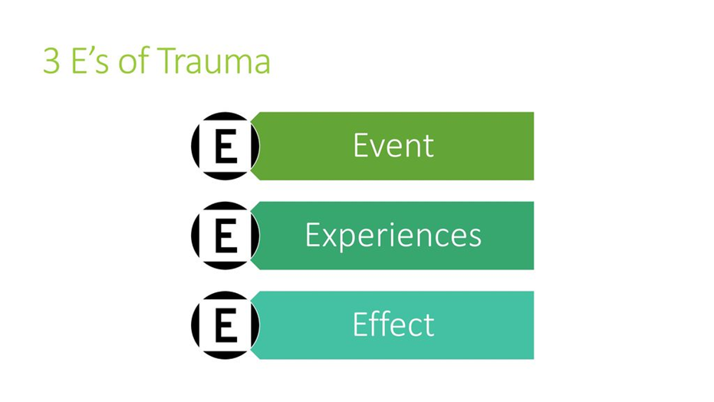
What is trauma?
“An event, series of events, or set of circumstances that is experienced by an individual as physically or emotionally harmful or life threatening and that has lasting adverse effects on the individual’s functioning and mental, physical, social, emotional, or spiritual well-being.”
SAMHSA (Substance Abuse and Mental Health Services Administration)
Notes:
So to start with definitions- the substance abuse and mental health services administration, or SAMHSA, which has done a lot of work around trauma informed care, and for which I have a link at the end for those who are interested uses the definition you see here.
They also describe the 3 E’s of trauma that you see at the right here, and this can be helpful to parse out.
It separates the event from the individual’s experience of the event and the meaning they make of it (for example whether it is something seen as shameful)– and finally the effects of trauma- which can be- immediate or delayed

Slide 8
Types of trauma
Natural and human-caused disasters
Community Violence
School Violence
Family Trauma
Refugee and Immigrant Trauma
Medical Trauma
Poverty
Historical Trauma
Racial Trauma
Notes:
This is a list- not exhaustive – of different types of trauma- I’m sure that there are others that those of you here could add to the list
Natural disasters: hurricanes, fires, floods
Human-caused disasters: accidents, wars, environmental disasters, acts of terrorism
Community violence: robberies, shootings, assault, gang-related violence, hate crimes, group trauma affecting a particular community
School violence: threats, fights, school shootings, bullying, loss of a student or staff member
Family trauma: abuse, neglect, experiencing or witnessing domestic violence, incarceration of family members, family substance abuse, sudden or expected loss of a loved one
Refugee and Immigrant trauma: exposure to war, political violence, torture, forced displacement, migration and acculturation stressors, fears of deportation
Medical trauma: pain, injury and serious illness; invasive medical procedures or treatments
Poverty: lack of resources, support networks, or mobility; financial stressors; homelessness

Slide 9
Cumulative Trauma
Historical trauma
Community level trauma
Trauma
History
Acute Traumatic experience
Racism (structural and/or interpersonal)
Generational Poverty
Slavery
Holocaust survivors
Unsafe housing and/or neighborhoods
Gang and/or gun violence
Racism (structural and/or interpersonal
Food scarcity
ACEs
Natural disaster
Car accident
Divorce
Interpersonal violence
Primary caregiver of someone ill or disabled
Vicarious trauma
Complex Trauma: Exposure to multiple traumatic events from an early age
Notes:
And then there is the issue of cumulative trauma- as many of the children that we see experience more than one traumatic event. This is an example of different layers of trauma that might be experienced by an individual, and as you can imagine, the cumulative effect can be wide ranging, particularly when experienced at an early age

Slide 10
Adverse Childhood Experiences
CDC and Kaiser Permanente in CA.
2/3 at least 1 ACE and >1/5 reported 3 or more.
Serious health consequences:
Health risk behaviors
Severe medical conditions
Early death
Felitti et al 1998
Notes:
I am guessing that the ACEs study is well known these days- but this is an example of the effect of cumulative traumatic or adverse experience, with increasing adverse experiences being associated with higher rates of long-erm health and mental health effects even in adulthood.
Children Who Experience Four or More ACEs:
10–12x greater risk for Intravenous Drug Use and Attempted Suicide
2–3x greater risk for developing Heart Disease and Cancer
32x more likely to have Learning and Behavioral Problems
8 out of 10 Leading Cause of Death in the U.S. correlate with exposure to four or more ACEs

Slide 11
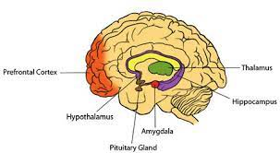
Neurobiology of Stress Response
Brain areas
Amygdala (‘alarm system’, emotion/fear center)
Hippocampus (learning, memory, context)
Prefrontal cortex (executive function, regulatory)
Neurochemical systems
Cortisol
Norepinephrine
Impacts
Decreased connectivity
Notes:
And again, this could be a presentation in and of itself, but I wanted to show this just to put a context to some of the symptoms that we will be discussing. It’s thought that a number of the effects of trauma are related to dysfunction of the cortisol system, and the effect that that can have on different areas of the brain, including decreased connectivity between the prefrontal cortex which has a role in executive function and emotion regulations, and other parts of the brain.
Dissociation. Some traumatized children experience a feeling of detachment or depersonalization, as if they are “observing” something happening to them that is unreal.
Behavioral control. Traumatized children can show poor impulse control, self-destructive behavior, and aggression towards others.
Cognition. Traumatized children can have problems focusing on and completing tasks, or planning for and anticipating future events. Some exhibit learning difficulties and problems with language development.

Slide 12
Impact of trauma
Short and long-term effects
Coping responses
Relationships
Developmental tasks
Physiologic effects
Effects are increased when:
Early occurrence
Being silenced, blamed, shamed or not believed
These emotions impede healing.
Perpetrator is a trusted caregiver
Notes:
And a little overview of the effects- they can be wide ranging, including effects on interpersonal relationships, acquisition of developmental tasks, and physiologic effects.
The effects are often increased in cases where trauma occurred early and when the perpetrator is a trusted caregiver

Slide 13
Signs that a child might have a history of trauma
Infant: developmental delay, failure to thrive
Toddler: frequent tantrums, aggressive, easily frustrated
School Aged Child: Difficulty at school, difficulty with peers, fighting
May look like learning problems or ADHD*
Adolescent: School difficulties, risk taking behavior, anxiety and mood symptoms
Notes:
Here are some potential specific signs, though obviously all of these have a wide differential. I put an asterik by ADHD because I will be coming back to that specifically

Slide 14
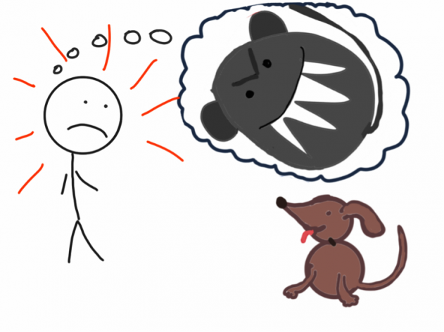
Trauma Triggers
Reminders of past trauma that automatically cause the body to react as if the traumatic event is happening again in that moment.
Loud noises
Physical touch
Threatening gestures
Authority figures and limit-setting
Chaos or uncertainty
Particular spaces (e.g., bathrooms or less monitored spaces)
Changes in routine
Witnessing violence between others, such as peers fighting
Emergency vehicles and police or fire personnel
Notes:
I’m bringing up the concept of trauma triggers here because as you look at this list, many of the things that may remind patients- or family members- of past trauma may be things that happen every day in the office, or in the school or community

Slide 15
Trauma Triggers
Responses can appear confusing and out of place and be misunderstood by others.
Fight responses: yelling, swearing, posturing, aggressive behavior;
Flight responses: running away, refusing to talk, avoidance, substance use; and
Freeze responses: spacing out; appearing numb, disconnected, confused, or unresponsive.
Notes:
And so the impact of experiencing those triggers can lead to some of the responses described here

Slide 16
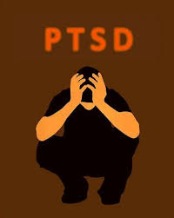
Posttraumatic stress disorder
Exposure to traumatic event
Exposure: Direct experience, Witness to, Hearing about
Traumatic: Experienced as physically/emotionally harmful/life-threatening
Core Symptoms
Intrusion: recurrent/involuntary/distressing memories, nightmares, play, reaction to cues
Alterations in mood/cognitions associated w/event (‘I am bad’, ‘no one can be trusted’)
Avoidance of stimuli associated w/event(s)
Arousal (hypervigilance, sleep disturbance, irritability, impaired concentration)
Not everyone who experiences trauma develops PTSD- varies by
Type of trauma
Proximity to trauma
Duration
Availability of adult
Child characteristics (gender, age, comorbidity, etc.)
Notes:
I won’t go through all the symptoms in the interest of time, because you will have a copy of these slides, but these are some of the core symptoms of post traumatic stress disorder, including intrusive symptoms like recurrent memories or nightmares, impact of mood or cognitions, avoidance of stimuli associated with the event, such as trauma triggers, and hyperarousal

Slide 17
Trauma as the “Great Imitator”
Symptom Domains
-Mood/mood regulation
-Aggression
-Attention
-Impulse Control
-Sleep
Notes:
And again, I won’t read through these, but this is a reminder that that trauma can present in many different ways- the example here describes overlapping features of trauma and ADHD, and when you think about the impact of cortisol dysfunction on the prefrontal cortex and regulatory functions in the brain, that makes sense

Slide 18
Trauma, Parenting and Caregiving
Often parents themselves have a history of trauma
Parents with a history of trauma may be less able to respond to the stresses of parenting in a healthy way
Parents may present in the office as:
irritable, hostile or even aggressive
poor memory (missed appointments)
reluctant to discuss problems
many needs
Notes:
This is a reminder that we care for kids in the context of their families, and many of the kids we see may have parents who have also experienced trauma, and who may experience challenges in parenting or difficulty with some of the same triggers I described earlier
Adults who have experienced ACEs in their early years may have changes in their stress-response system, may have diminished capacity to respond to additional stressors in a healthy way

Slide 19
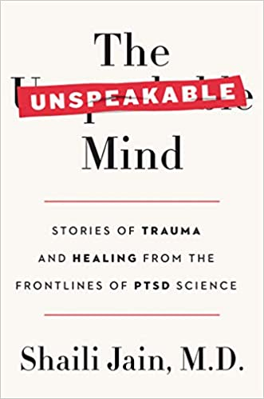
Books about Trauma and Recovery

Slide 20
So…what do we do?
Trauma-Informed Care/Trauma-Informed Systems

Slide 21
What is a Trauma-Informed System? SAMHSA’s “4 R’s”
Realizes the widespread impact of trauma & understands potential paths for recovery
Recognition of prevalence
Importance of relationships to recovery
Recognizes the signs and symptoms of trauma in patients, families, staff, and others involved with the system
Screening
Attends to patient and staff wellness/resilience
Responds by fully integrating knowledge about trauma into policies, procedures, and practices
Attention to environment- physically and psychologically safe throughout: “Universal Precautions”
Availability of Information and Resources
Seeks to actively resist re-traumatization
Recognize impacts of organizational practices (e.g., use of restraints/security) may re-traumatize clients/staff with trauma histories
Distinct from trauma-specific interventions or treatments that are designed specifically to address the consequences of trauma and to facilitate healing
Notes:
Again, I’m going to go back to SAMHSA and encourage you all to look at some of the resources to go more in-depth on this, but I wanted to outline a few of the features of trauma-informed care when we think about how to devise a system that can better meet the needs of traumatized children and families. SAMHSA describes the 4 R’s of a trauma-informed system, including recognition of the prevalence for trauma as well as paths to recovery, many of which include trusted relationships. They also describe recognition of the signs and symptoms of trauma, not only in patients and families, but also of staff. Recognition of symptoms can happen through incorporation of screening, and I’ll describe a few examples of tools in a few slides. There is the Response to trauma- and that involves how knowledge of some of the things above are translated into policies and procedures in terms of how patients, families and staff may experience the healthcare environment- and this is for everyone, taking universal precautions. This includes providing information for families- and I’ll describe some sites that have examples of resources, as well as an awareness of local resources to refer patients and families to- and I say that because while it would be nice to have trauma specific interventions or treatments directly in your clinics, that isnt necessarily realistic.

Slide 22
Screening: Asking about Trauma
First, check the chart! Trauma history may already be thoroughly documented.
Let families know trauma is common, important, & OK to talk about
Consider systematic screening
Single Question: +/-Since the last time I saw you/your child has anything really scary or upsetting happened to you or your family?
Example Instruments:
Children’s Impact of Events Scale(8) https://www.corc.uk.net/media/1268/cries_selfreported.pdf
ACE-Q Child (https://centerforyouthwellness.org/aceq-pdf/)
SEEK Parent Questionnaire (https://seekwellbeing.org/seek-materials/)
Cohen et al 2008
Notes:
So again, going to some more specific examples, once of the most important things that can happen is just to set the stage that it is ok to talk about trauma in the office. There are some example of specific screeners here, and also a potential single question. Other ways to raise the topic include things like posters and handouts, and the NCTSN has a lot of great handouts available for free- I have that link at the end of the presentation- we are almost there!

Slide 23
When a family discloses trauma
Provide family reassurance that they are not alone
The medical home will not be a place for assigning blame but rather to help support the family and connect them with the services they need.
“I am so sorry to hear that you ______. Thank you for sharing that information with me. I know we can work together to help”
“It is not your fault”
Notes:
Here are some examples of things that you can say when a family discloses trauma- recognizing that shame and isolation are often powerful after-effects of trauma and working to counteract that

Slide 24
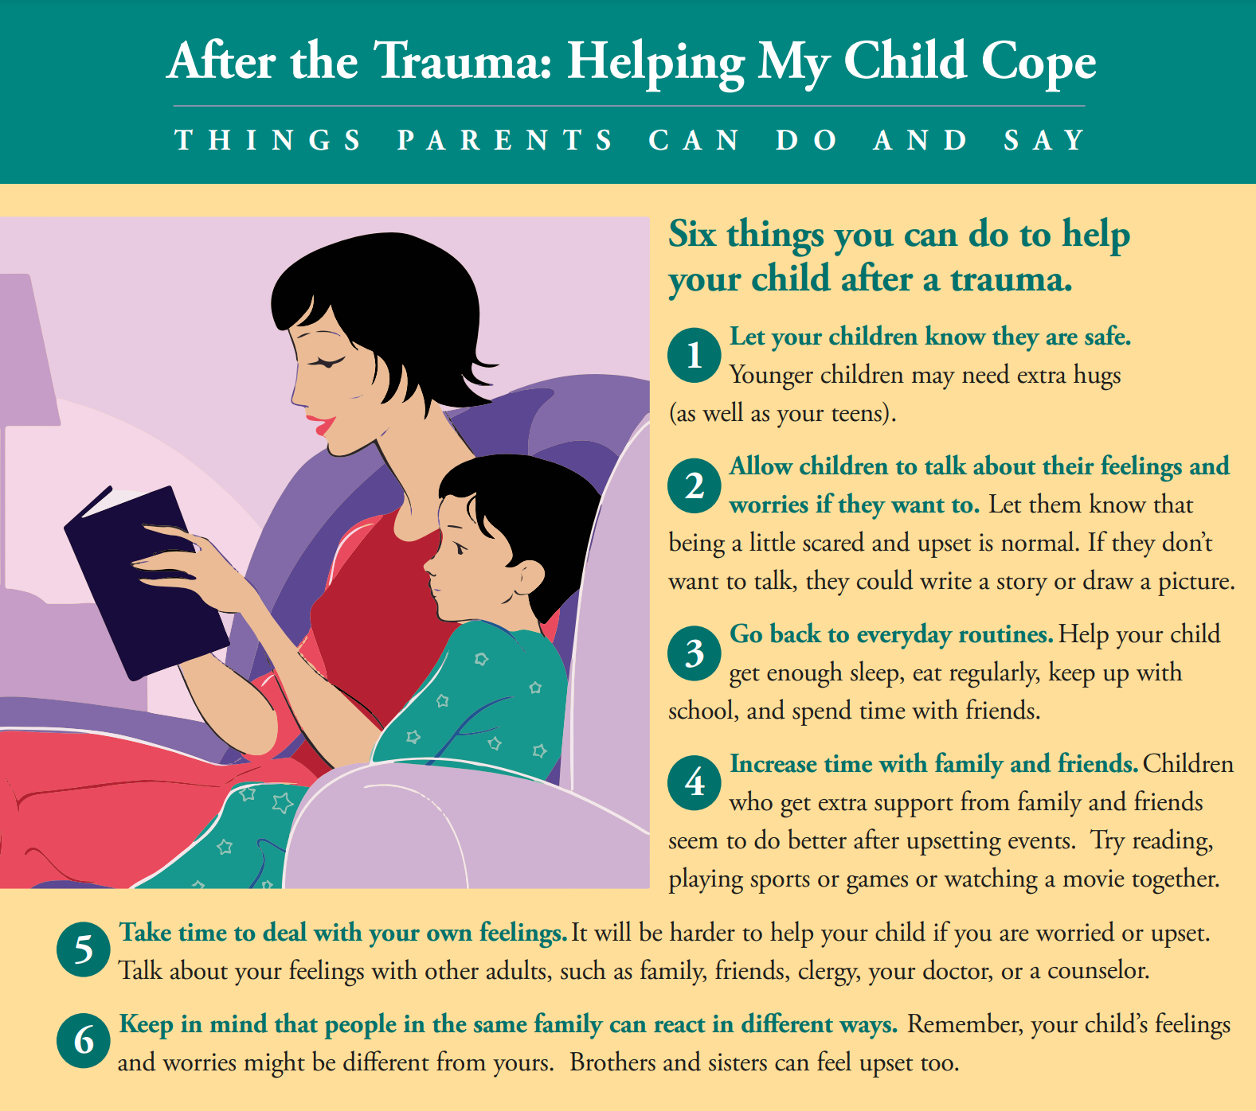
When a family discloses trauma
Elicit further symptoms and provide education
“What differences have you noticed in your child since the event?”
Remind families of common symptoms after trauma
May require follow-up or referral
Identification of resources ahead of time
Help parents cope and self-care
Caring for a child who has been traumatized can be challenging
Resources for parents, teens, providers and regularly updated
NCTSN.org
Notes:
And here are some other examples of ways to respond- in addition to gathering more information, being able to provide education- and here again is where there are really great family education resources on NCTSN. In some cases, it will be clear that the patient and family need additional services and support, and making sure that you are aware of those supports ahead of time can be helpful- that being said, we also know how challenging it has been to access services recently- and I want to acknowledge that here.

Slide 25
SAMHSA- 5 Principles of Trauma-Informed Approach
Notes:
This is another infographic from Samhsa giving some examples of ways that trauma-informed principles can be put into practice. You’ll see here that several of the concepts involve affirmation, autonomy and control- these things being missing is often a characteristic of many traumatic experiences

Slide 26
Potentially Retraumatizing Practices
One essential feature of trauma-informed care is the focus on ensuring that treatments and settings do not inadvertently retraumatize patients.
Unfortunately, hospitalizations involve a range of standard clinical practices that can iatrogenically trigger trauma symptoms or reenactments.
1) Boundary Violations: Touching without permission, walking into the patient’s room without knocking
2) Forced or Threatened Medications
3) Seclusion and Restraint
Butler et al 2011

Slide 27
Trauma-Informed Practice in Action
Our goal is to create an atmosphere that is respectful of the trauma survivors’ need for safety, respect, and acceptance while striving to minimize the possibility of retraumatization.
Butler et al 2011

Slide 28
Safety
An atmosphere that is respectful of survivor’s need for safety, respect, and acceptance is fundamental for building trust and therapeutic engagement.
“Do I have your permission to examine you?” Clearly communicate that the patient may stop the exam at any time.
Provider should explain each step of the exam: “Now I’m going to put the stethoscope on your chest to listen to your heart.”
Knock before entering the room.
Offer a chaperone.
Obtain consent to have trainees present during the exam before the trainee(s) come into the room.

Slide 29
Safety
How can we safely de-escalate an agitated patient without using medication, seclusion, and restraint?

Slide 30
General Considerations for Management
Use environmental, behavioral techniques
Emphasize effective communication and behavioral strategies for managing behaviors
Always treat underlying cause of agitation first whenever possible…
Before medication!
PRN usage if those avenues are not successful

Slide 31
BETA 3-step Paradigm Approach
The patient is verbally engaged
Then a collaborative relationship is established
The patient is verbally deescalated out of the agitated state
Verbal de-escalation is usually the key to engaging the patient and helping him become an active partner in his evaluation and treatment.
West J Emerg Med. 2012;13(1):17–25

Slide 32
10 Principles of Verbal De-escalation
Respect the personal space of the individual; do not get uncomfortably close or block exits.
Do not be provocative or respond in anger, be in control and measured.
Establish verbal contact calmly with the individual.
Be concise and speak in short, easy to understand sentences or phrases. Repeat yourself often.
Listen closely to what the person is saying.

Slide 33
10 Principles of Verbal De-escalation
Identify the individual’s wants and feelings and try to accommodate reasonable requests.
Agree or agree to disagree with the person’s concerns, while avoiding negative statements.
Set clear limits with expected outcomes, but do not make demands or order specific behavior.
Offer choices and optimism.
Afterwards, review the event and look for areas of improvement.

Slide 34
Thank you!
Maryland Behavioral Health Integration in Pediatric Primary Care (BHIPP)
1-855-MD-BHIPP (632-4477)
www.mdbhipp.org
Follow us on Facebook, LinkedIn, and Twitter! @MDBHIPP
For resources related to the COVID-19 pandemic,
please visit us at BHIPP Covid-19 Resources.
Notes:
You will receive a copy of these slides

Slide 35
Resources
National Child Traumatic Stress Network (NCTSN): https://www.nctsn.org/
Trauma-Informed Care Implementation Resource Center: https://www.traumainformedcare.chcs.org/
Georgetown University Center for Trauma and the Community: https://ctc.georgetown.edu/toolkit/
AAP Clinical Report- Trauma-Informed Care: Pediatrics (2021) 148 (2): e2021052580.
SAMHSA guidance for trauma-informed approach: https://store.samhsa.gov/product/SAMHSA-s-Concept-of-Trauma-and-Guidance-for-a-Trauma-Informed-Approach/SMA14-4884?referer=from_search_result

